Slide 1
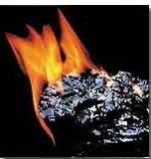
Fuels and Fuel Cells
Professor Tian Li
School of Mechanical Engineering
Purdue University

Slide 2
Outline
Fossil Fuels
“Synthetic” Fuels
Carbon Mitigation Strategies
Hydrogen Fuels and Fuel Cells

Slide 3
Proven Fuel Reserves
Fuel | Proven Reserves (EJ)
Coal¹ | 31,340
Oil¹ | 10,057
Natural Gas¹ | 7,442
Uranium² | 2,000 (once through reactors, < 1% efficient) 10,000 – 190,000 (reprocessing & breeding reactors, 5% to 95% efficient)
Proven = 90% probability of being recoverable under existing
economic and political conditions with existing technology
1 - Statistical Review of World Energy 2020, BP
2 - http://en.wikipedia.org/wiki/World_energy_resources; https://en.wikipedia.org/wiki/Breeder_reactor
Notes:
Coal and Oil, BP report
Uranium: IPCC

Slide 4
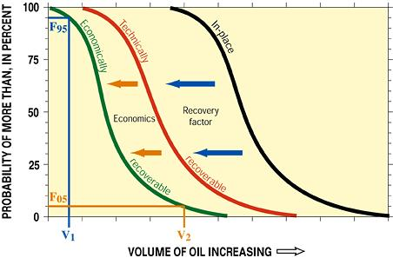
Proven vs. Unproven Reserves
Proven: 90% probability of being recoverable under existing economic & political conditions, with existing technology
Probable: 50% probability of recovery
Example showing a 95% chance (i.e., probability, F95) of at least volume V1 of economically recoverable oil, and there is a 5% chance (F05) of at least volume V2 of economically recoverable oil.

Slide 5
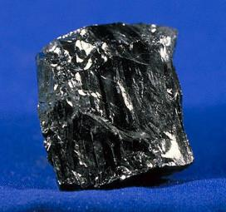
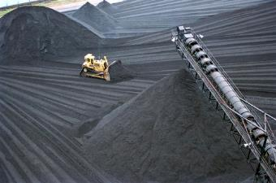
Coal
Compact stratified mass of metamorphosed plant (trees, bushes, ferns, mosses,
Metamorphosed by heat, pressure, etc. over millions of years
Various forms due to different geological histories
  Lignite: 46% to 60% carbon, 5,500-to 8,300 Btu/lb
  Bituminous: 46% to 86%carbon, 8,300–15,600 Btu/lb
  Anthracite: 86% to 98% carbon, 13,500–15,600 Btu/lb
Significant amounts of sulfur nitrogen, and hydrogen
Notes:
Increase the heating value, with higher content of carbon
SO2 Nox

Slide 6
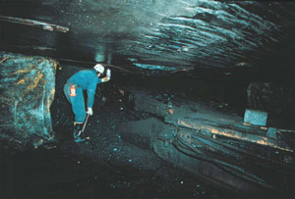
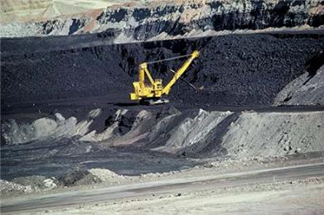
Coal Mining
Underground Mine
Open Pit Mine
Most coal seams run too deep for surface mining
~60% of world mining
Recovers greater portion of available coal
Typically start with explosives
Most bituminous coal
~67% of US production
Notes:
Land uses
Health issues for underground mining, for miners
>100,000 in US workers killed over 100 years

Slide 7
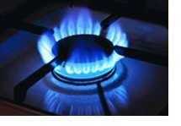
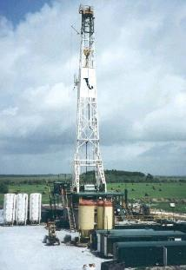
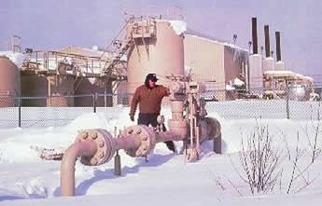
Natural Gas
Mixture of hydrocarbon gases
  70 – 90% methane (CH4)
  Ethane, propane, butane, ..
Found in porous rocks, alone or mixed with petroleum
Notes:
Propane butane useful in their own rights, separated. Liquifiy them in room condition, can buy in stores
About ½ carbon content per heating value, -- low GHG heating potential

Slide 8
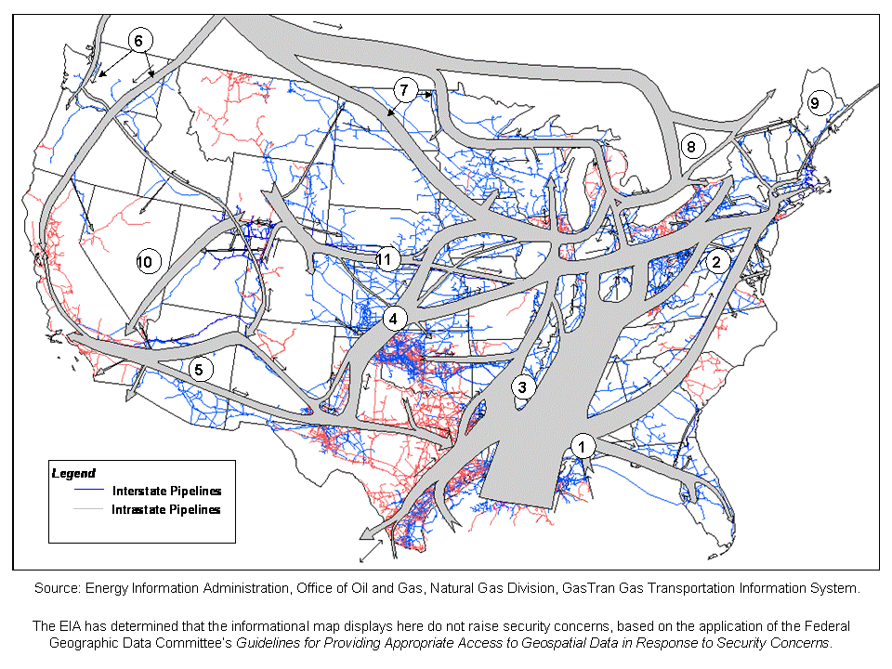
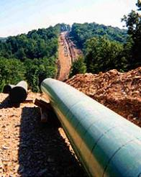
North American Natural Gas Flows

Slide 9
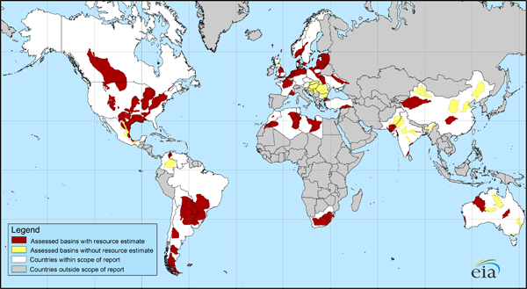
Shale Gas
Natural gas produced from shale formations
Expected to be a major source for natural gas in the future
Requires hydraulic fracturing of shale for commercial extraction
One of a number of unconventional sources of natural gas, including coal-bed methane, tight sandstones, and methane hydrates
Large reserves in the northeast part of the U.S.
Economics depend on the price of natural gas (i.e., the supply of conventional sources)
Whole Shale Gas
http://www.eia.gov/analysis/studies/worldshalegas/
Notes:
Already happening in US. Due to the shale natural gas that allows us to shift from coal
40% of current US production, keep the price low

Slide 10
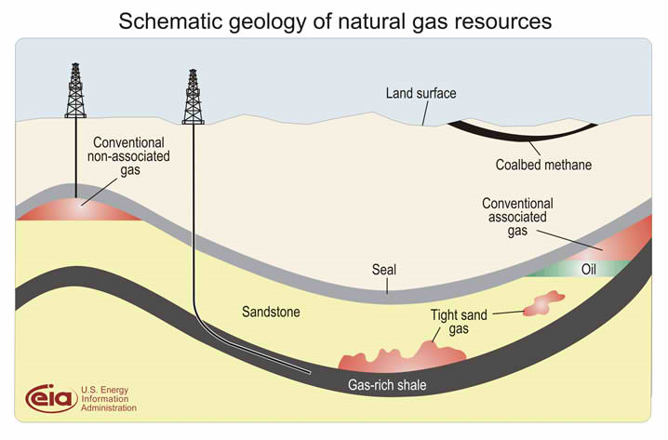
Shale Gas
Notes:
Fossil fuel – natural gas
Environmental benefits: leaking, water mixed with chemicals, opens up cracks,
Getting methane into atmosphere

Slide 11
Shale Gas Resources (2013)
Country | Estimated Recoverable Shale Gas (trillion cubic feet) | Proven Natural Gas Reserves of All Types (trillion cubic feet)
China | 1,115 | 124
Argentina | 802 | 12
Algeria | 707 | 159
U.S. | 665 | 318
Canada | 573 | 68
Mexico | 545 | 17
S. Africa | 485 | -
Australia | 437 | 43
Russia | 285 | 1,688
Brazil | 245 | 14
Proven = 90% probability of being recoverable under existing
economic and political conditions with existing technology
http://en.wikipedia.org/wiki/Shale_gas
Notes:
Estimated recoerbable shale gas become to proven

Slide 12
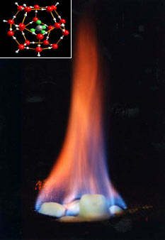
Natural Gas (Methane) Hydrates
large amounts of methane trapped within the crystal structure of water ice found in deep sedimentary structures
  polar continental sedimentary rocks
  deep Antarctic ice cores
  oceanic sediment at water depths greater than 300 m
  continental deposits sandstone and siltstone beds at less than 800 m depth.
formed by migration of gas along geological faults, followed by precipitation, or crystallization, on contact with cold sea water
~ 1 mole of methane for every 5.75 moles of water
~1 liter of methane clathrate solid contains 168 liters of methane gas (at STP)
Considered to be “unconventional” fuel (not part of proven reserves)
Significant green house gas that could be released with global warming
"Burning ice“: Methane, released by heating, burns; water drips.
Notes:
Under permafrost
Beneath ocean floor
Clathrate: hydrate

Slide 13
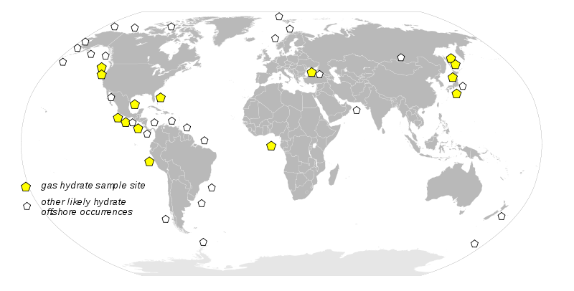
Potential Methane Hydrate Reserves
Estimated inventory 500-2500 gigatonnes of methane compared to 230 gigatonnes of natural gas (Milkov, AV (2004). "Global estimates of hydrate-bound gas in marine sediments: how much is really out there?". Earth-Sci Rev 66 (3-4): 183–197)

Slide 14
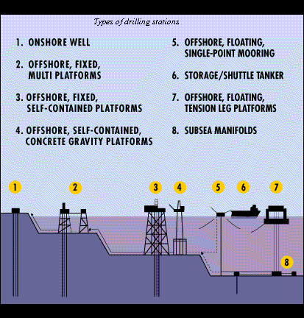

Petroleum
“rock” oil formed from organic precursors
Mostly carbon and hydrogen, but also contains sulfur and nitrogen
Notes:
Precursor： kerogen

Slide 15
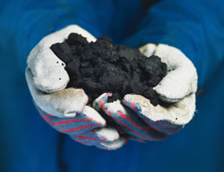

Tar Sands
Sand or sandstone impregnated with up to 18% bitumen
  Highly viscous, asphalt-like hydrocarbon substance
  Soluble in carbon disulphide
~ 50% bitumen can be recovered from the sand by heating
Bitumen also contains sulfur and nitrogen
About 50% of Canadian oil production is from tar sands (20% of U.S. imports from Canada)
Notes:
Only relatively interest, recently, within last 20 years. Become part of proven reserve as price of ooil incrase
Un-conventional
Bitumen – then produced to liquid fuel
~ 12% greater green house gas emission than oil extraction

Slide 16

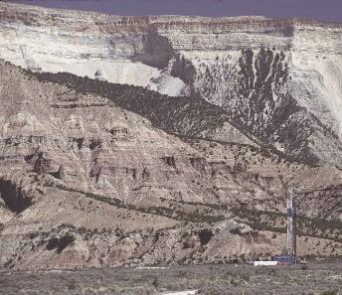
Oil Shale
Fine-grained sedimentary rock containing kerogen
  carbon and hydrogen
  can produce liquid fuel from heating
~ 10 to 30 gallons of liquid can be produced per ton of oil shale
~ 3 trillion barrels of recoverable oil on earth
Current use of oil shale is relatively small
Notes:
Mining, then processing (pyrolysis) to obtain shale oil
similar to available conventional oil, but require lots of land use

Slide 17
Ultra-Heavy Oil
Extremely high viscosity and density
Less than 10% can be recovered by conventional pumping
Variety of approaches to heat oil & reduce viscosity (all require significant energy input)
  Steam injection
  Controlled in-situ combustion using air injection
Must extensively process to derive fuel products (requiring high energy input)

Slide 18
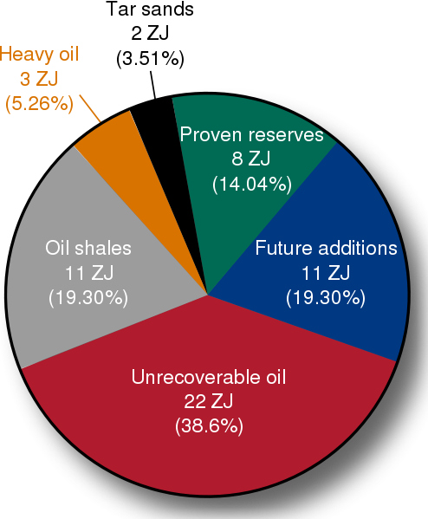
“Unconventional” vs. Conventional Oil
2005
http://en.wikipedia.org/wiki/World_energy_resources
Notes:
1 zj = 10^1’’’’’’’
2 ]]
[‘

Slide 19
Fuel Comparisons
Fuel | H/C, Atomic | HHV (kcal/g)
Gaseous
Methane | 4.0 | 13.3
Natural Gas | 3.5 – 4.0 | 11.7-11.9
Hydrogen | - | 33.9
Liquid
Methanol | 4.0 | 5.3
Gasoline | 2.0-2.2 | 11.2-11.4
Crude shale oil | 1.6 | 10.3-10.4
Bitumen (tar sands) | 1.4-1.5 | 9.8-10
Solid
Lignite Coal | 0.8 | 3.9-5.4
Bituminous Coal | 0.5-0.9 | 6.7-8.8
Anthracite Coal | 0.3 | 8.4
http://www.eia.doe.gov/oiaf/1605/coefficients.html

Slide 20
Comparisons of Fuel CO₂ Emissions
Fuel | lbs CO2 per MMBTU
Methane | 115
Natural Gas | 117
Propane | 139
Automobile Gasoline | 156
Wood and Wood Waste¹ | 195
Municipal Solid Waste¹ | 200
Coal (bituminous) | 205
Coal (subbituminous) | 213
Coal (lignite) | 215
Coal (anthracite) | 227
1. Biofuels contain "biogenic" carbon. Under international greenhouse gas accounting methods developed by the Intergovernmental Panel on Climate Change, biogenic carbon is part of the natural carbon balance and it will not add to atmospheric concentrations of carbon dioxide.
http://www.eia.doe.gov/oiaf/1605/coefficients.html

Slide 21
Typical Coal-Fired Power Plant
Category | Power Plant | 100W Light Bulb
Power | 500 MW | 100 W
Energy / year | 3.5 billion kWh | 876 kWh
Coal / year | 1.43 million tons | 714 lbs
Sulfur Dioxide / year | 10,000 Tons | 5 pounds
Nitrogen Oxides / year | 10,200 Tons | 5.1 pounds
Carbon Dioxide / year | 3,700,000 Tons | 1,852 pounds
Notes:
Current CO2 emission per capita
5 ton CO2 per person per year for world; ~ 18 ton in us

Slide 22
Synthetic Fuels
Typical gasoline and diesel prices are cheaper than bottled water in the U.S.
Charging rate of 5-10 MW when fueling a vehicle
  How can electric or fuel-cell vehicles ever compete?
Cost to replace global infrastructure for liquid transportation is estimated to be $3-5 trillion
Significant R&D to develop cost-effective methods for producing liquid and gaseous fuels from non-petroleum sources (coal, biomass)

Slide 23
Coal Pyrolysis
Most common approach for converting coal to alternative fuels
Chemical decomposition of organic substances by heating
Gas (H₂, CH₄, CO₂, CO, ..)
Heat
Coal
Liquids (tar, light oils, liquor)
Char (coke)
Tars require additional (e.g., hydrogenation) processing to produce liquid fuels
Notes:
Heat – without o2
Char == used for steel production

Slide 24
Coal Liquefaction
Direct conversion: reaction of coal “slurry” with hydrogen to produce liquid fuel (coal is hydrogen deficient)
  Requires hydrogen from electrolysis, natural gas reforming, or coal gasification
Indirect conversion: two-step process
  Coal is gasified to make syngas (a balanced purified mixture of CO and H₂ gas, CO + yH₂ ).
  Fischer-Tropsch catalysts are used to convert syngas into light hydrocarbons (like ethane) which are further processed into gasoline and diesel
Greenhouse gas emissions are generally greater than those released in the extraction and refinement of liquid fuel production from crude oil.
Notes:
Hydrogenation process requires high temp and catalyst
Coal very deficient in H, carbon
Ethane C2H6
Process is highly centralized, can capture Carbon

Slide 25
Coal Gasification
Variety of fuels with different heating values are possible
Air
Low HV Gas (CO,H₂,CH₄, N₂)
Steam
Coal
O₂
Intermediate HV (CO,H₂,CH₄)
Steam
O₂
Synthesis Gas (CO + yH₂)
Steam
Tars
Byproducts
Light Oils
Byproducts
Ammonia
Sulfur
Notes:
Blow through heated air/O2
O2 required separation
Syn gas: right amount of O2 and H2O; to get more H2: CO+H2O= CO2 and H2

Slide 26
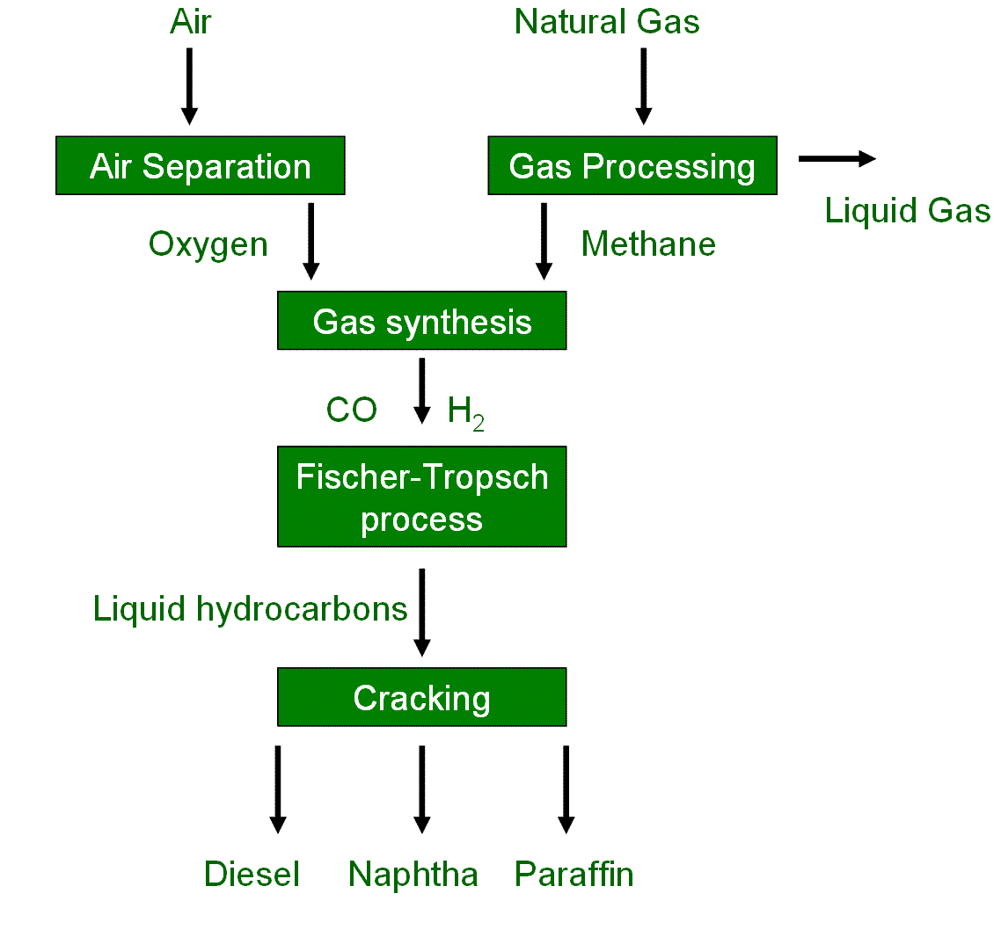
Natural Gas to Liquid Fuels
Gas synthesis reaction:
Requires heat input (endothermic)
Notes:
Liquid gas: Propane, butane
Naphtha: light hydrocarbon
Paraffin: lubricant
Cracking: typically refining process

Slide 27
Fischer-Tropsch Process
Uses syngas as an input to produce alkanes with primary reactions of the form:
  Requires heat input (endothermic) and catalyst (transition metals such as cobalt or iron)
  n > 1 for gasoline and diesel fuel
Another important reaction is the water gas shift reaction
  can shift the H2:CO ratio of the incoming synthesis gas.
  important for synthesis gas derived from coal
Notes:
Alkanes: Saturated hydrocarbons

Slide 28
Example Fuels from Synthesis Gas
CO + yH₂
(Synthesis Gas)
High HV Gas
(Synthetic Natural Gas)
Liquid Fuels
Coal Liquefaction
Hydrogen
Nitrogen Catalytic
Processing
Ammonia
Fischer-Tropsch Fuels
Methanol
Gasoline
Catalytic Processing
Notes:
High HV gas: reaction with CO2
Methanol: CH3OH

Slide 29
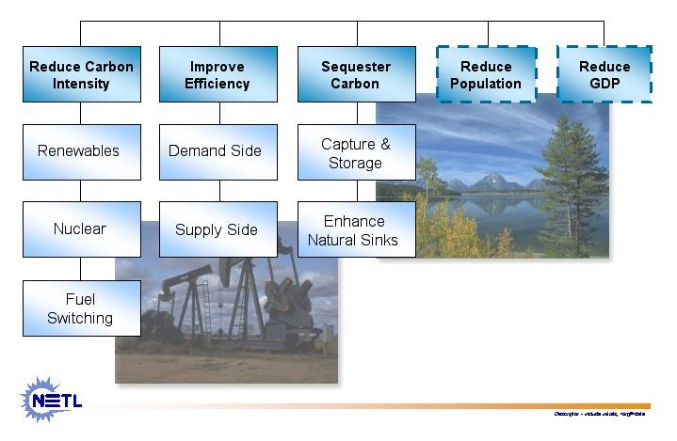
CO₂ Mitigation Options

Slide 30
Improve Energy Efficiency
Demand Side
  Building Sector
  Transportation Sector
  Industrial Sector
Supply Side
  Power Generation Sector
Notes:
Building: slower turn around
Supply side: Combined cycle; co-generation
Carbon capture and storage technologies allow emissions of carbon dioxide to be ‘captured’ and ‘stored’ i.e. they are removed from the exhaust gases of the power station (either from conventional combustion or from gasification), and stored in such a way that they do not enter the atmosphere – thus reducing global warming.
Carbon storage is not yet cost-effective, but the required technologies are already proven and have been used commercially in other areas such as the food industry and chemicals industry. The key is to bring the different elements together at an acceptable cost, and research is ongoing to achieve this goal.

Slide 31
Carbon Capture & Storage
Capture and store emissions of carbon dioxide
  Removed from the exhaust gases or prior to combustion
  Stored so as not to enter the atmosphere
    thus reducing global warming.
Carbon storage is not yet cost-effective
Required technologies are already proven
Similar technologies used commercially in food and chemicals industry
http://www.worldcoal.org
Notes:
Prior to combustion: to synthetic fuel, higher H/C ratio
Carbon capture and storage technologies allow emissions of carbon dioxide to be ‘captured’ and ‘stored’ i.e. they are removed from the exhaust gases of the power station (either from conventional combustion or from gasification), and stored in such a way that they do not enter the atmosphere – thus reducing global warming.
Carbon storage is not yet cost-effective, but the required technologies are already proven and have been used commercially in other areas such as the food industry and chemicals industry. The key is to bring the different elements together at an acceptable cost, and research is ongoing to achieve this goal.

Slide 32
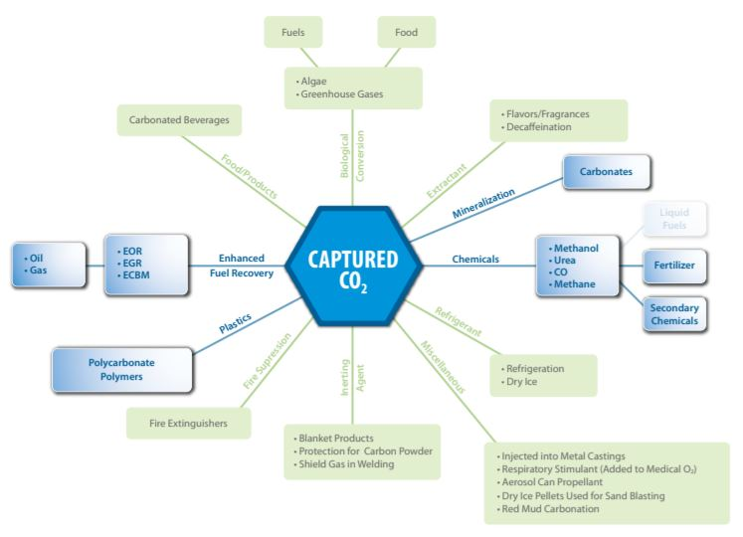
Carbon Capture & Storage
https://www.netl.doe.gov/File%20Library/Research/Coal/carbon-storage/Program-Plan-Carbon-Storage.pdf#page=39
Notes:
Carbon capture and storage technologies allow emissions of carbon dioxide to be ‘captured’ and ‘stored’ i.e. they are removed from the exhaust gases of the power station (either from conventional combustion or from gasification), and stored in such a way that they do not enter the atmosphere – thus reducing global warming.
Carbon storage is not yet cost-effective, but the required technologies are already proven and have been used commercially in other areas such as the food industry and chemicals industry. The key is to bring the different elements together at an acceptable cost, and research is ongoing to achieve this goal.

Slide 33
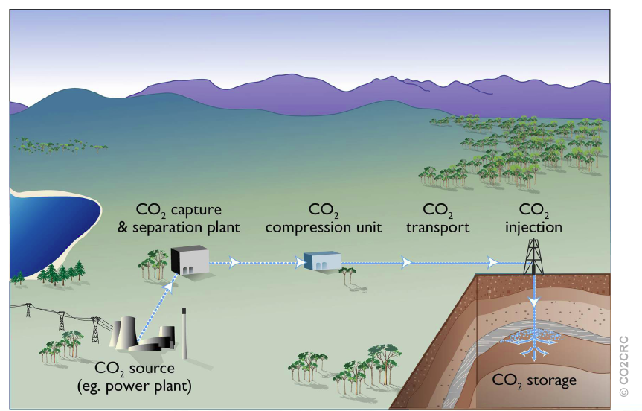
Carbon Capture & Storage Steps
Notes:
Before injection; or exhaust reaction
25% energy penalty in separation and storage
Carbon Capture Research
Before carbon dioxide (CO2) gas can be sequestered from power plants and other point sources, it must be captured as a relatively pure gas. On a mass basis, CO2 is the 19th largest commodity chemical in the United States, and CO2 is routinely separated and captured as a by-product from industrial processes such as synthetic ammonia production, H2 production, and limestone calcination.
Existing capture technologies, however, are not cost-effective when considered in the context of sequestering CO2 from power plants. Most power plants and other large point sources use air-fired combustors, a process that exhausts CO2 diluted with nitrogen. Flue gas from coal-fired power plants contains 10-12 percent CO2 by volume, while flue gas from natural gas combined cycle plants contains only 3-6 percent CO2. For effective carbon sequestration, the CO2 in these exhaust gases must be separated and concentrated.
CO2 is currently recovered from combustion exhaust by using amine absorbers and cryogenic coolers. The cost of CO2 capture using current technology, however, is on the order of $150 per ton of carbon - much too high for carbon emissions reduction applications. Analysis performed by SFA Pacific, Inc. indicates that adding existing technologies for CO2 capture to an electricity generation process could increase the cost of electricity by 2.5 cents to 4 cents/kWh depending on the type of process.
Furthermore, carbon dioxide capture is generally estimated to represent three-fourths of the total cost of a carbon capture, storage, transport, and sequestration system.
The program is pursuing evolutionary improvements in existing CO2 capture systems and also exploring revolutionary new capture and sequestration concepts. The most likely options currently identifiable for CO2 separation and capture include:
Absorption (chemical and physical)
Adsorption (physical and chemical)
Low-temperature distillation
Gas separation membranes
Mineralization and biomineralization
Opportunities for significant cost reductions exist since very little R&D has been devoted to CO2 capture and separation technologies. Several innovative schemes have been proposed that could significantly reduce CO2 capture costs, compared to conventional processes. "One box" concepts that combine CO2 capture with reduction of criteria pollutant emissions are being explored as well.
Examples of activities for this program element include:
Research on revolutionary improvements in CO2 separation and capture technologies
new materials (e.g., physical and chemical absorbents, carbon fiber molecular sieves, polymeric membranes);
micro-channel processing units with rapid kinetics;
CO2 hydrate formation and separation processes;
oxygen-enhanced combustion approaches;
Development of retrofittable CO2 reduction and capture options for existing large point sources of CO2 emissions such as electricity generation units, petroleum refineries, and cement and lime production facilities;
Integration of CO2 capture with advanced power cycles and technologies and with environmental control technologies for criteria pollutants.
http://www.fossil.energy.gov/programs/sequestration

Slide 34
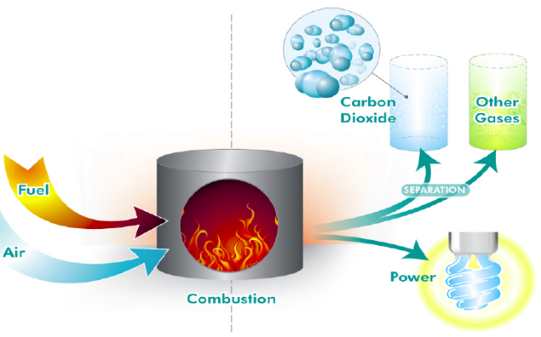
Capture: Post Combustion Capture
Post-combustion refers to capturing CO2 from a flue gas after a fuel has been combusted in air
Notes:
Carbon Capture Research
Before carbon dioxide (CO2) gas can be sequestered from power plants and other point sources, it must be captured as a relatively pure gas. On a mass basis, CO2 is the 19th largest commodity chemical in the United States, and CO2 is routinely separated and captured as a by-product from industrial processes such as synthetic ammonia production, H2 production, and limestone calcination.
Existing capture technologies, however, are not cost-effective when considered in the context of sequestering CO2 from power plants. Most power plants and other large point sources use air-fired combustors, a process that exhausts CO2 diluted with nitrogen. Flue gas from coal-fired power plants contains 10-12 percent CO2 by volume, while flue gas from natural gas combined cycle plants contains only 3-6 percent CO2. For effective carbon sequestration, the CO2 in these exhaust gases must be separated and concentrated.
CO2 is currently recovered from combustion exhaust by using amine absorbers and cryogenic coolers. The cost of CO2 capture using current technology, however, is on the order of $150 per ton of carbon - much too high for carbon emissions reduction applications. Analysis performed by SFA Pacific, Inc. indicates that adding existing technologies for CO2 capture to an electricity generation process could increase the cost of electricity by 2.5 cents to 4 cents/kWh depending on the type of process.
Furthermore, carbon dioxide capture is generally estimated to represent three-fourths of the total cost of a carbon capture, storage, transport, and sequestration system.
The program is pursuing evolutionary improvements in existing CO2 capture systems and also exploring revolutionary new capture and sequestration concepts. The most likely options currently identifiable for CO2 separation and capture include:
Absorption (chemical and physical)
Adsorption (physical and chemical)
Low-temperature distillation
Gas separation membranes
Mineralization and biomineralization
Opportunities for significant cost reductions exist since very little R&D has been devoted to CO2 capture and separation technologies. Several innovative schemes have been proposed that could significantly reduce CO2 capture costs, compared to conventional processes. "One box" concepts that combine CO2 capture with reduction of criteria pollutant emissions are being explored as well.
Examples of activities for this program element include:
Research on revolutionary improvements in CO2 separation and capture technologies
new materials (e.g., physical and chemical absorbents, carbon fiber molecular sieves, polymeric membranes);
micro-channel processing units with rapid kinetics;
CO2 hydrate formation and separation processes;
oxygen-enhanced combustion approaches;
Development of retrofittable CO2 reduction and capture options for existing large point sources of CO2 emissions such as electricity generation units, petroleum refineries, and cement and lime production facilities;
Integration of CO2 capture with advanced power cycles and technologies and with environmental control technologies for criteria pollutants.
http://www.fossil.energy.gov/programs/sequestration

Slide 35
Separation Approaches
Absorption (chemical and physical)
Adsorption (physical and chemical)
Low-temperature distillation
Gas separation membranes
Mineralization and bio-mineralization
http://www.fossil.energy.gov/programs/sequestration
Notes:
Absorption: chemical
Adsorption: physical, trap in pores; zeolite
Cyrogenics
React CO2 with minerals to form carbonate
Carbon Capture Research
Before carbon dioxide (CO2) gas can be sequestered from power plants and other point sources, it must be captured as a relatively pure gas. On a mass basis, CO2 is the 19th largest commodity chemical in the United States, and CO2 is routinely separated and captured as a by-product from industrial processes such as synthetic ammonia production, H2 production, and limestone calcination.
Existing capture technologies, however, are not cost-effective when considered in the context of sequestering CO2 from power plants. Most power plants and other large point sources use air-fired combustors, a process that exhausts CO2 diluted with nitrogen. Flue gas from coal-fired power plants contains 10-12 percent CO2 by volume, while flue gas from natural gas combined cycle plants contains only 3-6 percent CO2. For effective carbon sequestration, the CO2 in these exhaust gases must be separated and concentrated.
CO2 is currently recovered from combustion exhaust by using amine absorbers and cryogenic coolers. The cost of CO2 capture using current technology, however, is on the order of $150 per ton of carbon - much too high for carbon emissions reduction applications. Analysis performed by SFA Pacific, Inc. indicates that adding existing technologies for CO2 capture to an electricity generation process could increase the cost of electricity by 2.5 cents to 4 cents/kWh depending on the type of process.
Furthermore, carbon dioxide capture is generally estimated to represent three-fourths of the total cost of a carbon capture, storage, transport, and sequestration system.
The program is pursuing evolutionary improvements in existing CO2 capture systems and also exploring revolutionary new capture and sequestration concepts. The most likely options currently identifiable for CO2 separation and capture include:
Absorption (chemical and physical)
Adsorption (physical and chemical)
Low-temperature distillation
Gas separation membranes
Mineralization and biomineralization
Opportunities for significant cost reductions exist since very little R&D has been devoted to CO2 capture and separation technologies. Several innovative schemes have been proposed that could significantly reduce CO2 capture costs, compared to conventional processes. "One box" concepts that combine CO2 capture with reduction of criteria pollutant emissions are being explored as well.
Examples of activities for this program element include:
Research on revolutionary improvements in CO2 separation and capture technologies
new materials (e.g., physical and chemical absorbents, carbon fiber molecular sieves, polymeric membranes);
micro-channel processing units with rapid kinetics;
CO2 hydrate formation and separation processes;
oxygen-enhanced combustion approaches;
Development of retrofittable CO2 reduction and capture options for existing large point sources of CO2 emissions such as electricity generation units, petroleum refineries, and cement and lime production facilities;
Integration of CO2 capture with advanced power cycles and technologies and with environmental control technologies for criteria pollutants.
http://www.fossil.energy.gov/programs/sequestration

Slide 36
Capture: Amine (Current Approach)
Both conventional and modern types of coal-fired power plants can be adapted for CCS
Conventional coal-fired power plant:
  Burn coal in air (much like the old days)
  Exhaust gas is ~15 % CO₂ (rest is mostly nitrogen and water vapor)
  Exhaust gas flows over chemicals that selectively absorb CO₂ (‘amines’)
  The amines are heated to ~150 ºC to give up the CO₂ and produce a (nearly) pure CO₂ gas that can be sequestered.
Notes:
Carbon Capture Research
Before carbon dioxide (CO2) gas can be sequestered from power plants and other point sources, it must be captured as a relatively pure gas. On a mass basis, CO2 is the 19th largest commodity chemical in the United States, and CO2 is routinely separated and captured as a by-product from industrial processes such as synthetic ammonia production, H2 production, and limestone calcination.
Existing capture technologies, however, are not cost-effective when considered in the context of sequestering CO2 from power plants. Most power plants and other large point sources use air-fired combustors, a process that exhausts CO2 diluted with nitrogen. Flue gas from coal-fired power plants contains 10-12 percent CO2 by volume, while flue gas from natural gas combined cycle plants contains only 3-6 percent CO2. For effective carbon sequestration, the CO2 in these exhaust gases must be separated and concentrated.
CO2 is currently recovered from combustion exhaust by using amine absorbers and cryogenic coolers. The cost of CO2 capture using current technology, however, is on the order of $150 per ton of carbon - much too high for carbon emissions reduction applications. Analysis performed by SFA Pacific, Inc. indicates that adding existing technologies for CO2 capture to an electricity generation process could increase the cost of electricity by 2.5 cents to 4 cents/kWh depending on the type of process.
Furthermore, carbon dioxide capture is generally estimated to represent three-fourths of the total cost of a carbon capture, storage, transport, and sequestration system.
The program is pursuing evolutionary improvements in existing CO2 capture systems and also exploring revolutionary new capture and sequestration concepts. The most likely options currently identifiable for CO2 separation and capture include:
Absorption (chemical and physical)
Adsorption (physical and chemical)
Low-temperature distillation
Gas separation membranes
Mineralization and biomineralization
Opportunities for significant cost reductions exist since very little R&D has been devoted to CO2 capture and separation technologies. Several innovative schemes have been proposed that could significantly reduce CO2 capture costs, compared to conventional processes. "One box" concepts that combine CO2 capture with reduction of criteria pollutant emissions are being explored as well.
Examples of activities for this program element include:
Research on revolutionary improvements in CO2 separation and capture technologies
new materials (e.g., physical and chemical absorbents, carbon fiber molecular sieves, polymeric membranes);
micro-channel processing units with rapid kinetics;
CO2 hydrate formation and separation processes;
oxygen-enhanced combustion approaches;
Development of retrofittable CO2 reduction and capture options for existing large point sources of CO2 emissions such as electricity generation units, petroleum refineries, and cement and lime production facilities;
Integration of CO2 capture with advanced power cycles and technologies and with environmental control technologies for criteria pollutants.
http://www.fossil.energy.gov/programs/sequestration

Slide 37
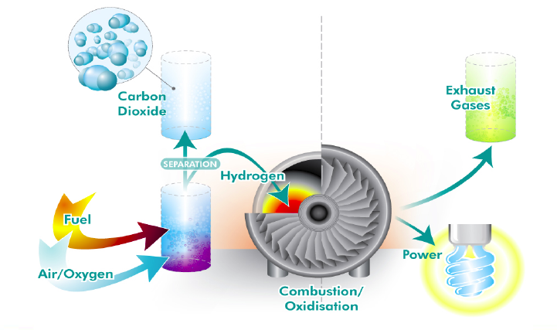
Capture: Pre-Combustion Capture
Pre-combustion process where hydrocarbon fuel is gasified and water-gas shifted to form a mixture of hydrogen and CO₂. CO₂ is captured from the synthetic gas and the H₂ is combusted. Often called IGCC (Integrated Gasification Combined Cycle)
Notes:
Carbon Capture Research
Before carbon dioxide (CO2) gas can be sequestered from power plants and other point sources, it must be captured as a relatively pure gas. On a mass basis, CO2 is the 19th largest commodity chemical in the United States, and CO2 is routinely separated and captured as a by-product from industrial processes such as synthetic ammonia production, H2 production, and limestone calcination.
Existing capture technologies, however, are not cost-effective when considered in the context of sequestering CO2 from power plants. Most power plants and other large point sources use air-fired combustors, a process that exhausts CO2 diluted with nitrogen. Flue gas from coal-fired power plants contains 10-12 percent CO2 by volume, while flue gas from natural gas combined cycle plants contains only 3-6 percent CO2. For effective carbon sequestration, the CO2 in these exhaust gases must be separated and concentrated.
CO2 is currently recovered from combustion exhaust by using amine absorbers and cryogenic coolers. The cost of CO2 capture using current technology, however, is on the order of $150 per ton of carbon - much too high for carbon emissions reduction applications. Analysis performed by SFA Pacific, Inc. indicates that adding existing technologies for CO2 capture to an electricity generation process could increase the cost of electricity by 2.5 cents to 4 cents/kWh depending on the type of process.
Furthermore, carbon dioxide capture is generally estimated to represent three-fourths of the total cost of a carbon capture, storage, transport, and sequestration system.
The program is pursuing evolutionary improvements in existing CO2 capture systems and also exploring revolutionary new capture and sequestration concepts. The most likely options currently identifiable for CO2 separation and capture include:
Absorption (chemical and physical)
Adsorption (physical and chemical)
Low-temperature distillation
Gas separation membranes
Mineralization and biomineralization
Opportunities for significant cost reductions exist since very little R&D has been devoted to CO2 capture and separation technologies. Several innovative schemes have been proposed that could significantly reduce CO2 capture costs, compared to conventional processes. "One box" concepts that combine CO2 capture with reduction of criteria pollutant emissions are being explored as well.
Examples of activities for this program element include:
Research on revolutionary improvements in CO2 separation and capture technologies
new materials (e.g., physical and chemical absorbents, carbon fiber molecular sieves, polymeric membranes);
micro-channel processing units with rapid kinetics;
CO2 hydrate formation and separation processes;
oxygen-enhanced combustion approaches;
Development of retrofittable CO2 reduction and capture options for existing large point sources of CO2 emissions such as electricity generation units, petroleum refineries, and cement and lime production facilities;
Integration of CO2 capture with advanced power cycles and technologies and with environmental control technologies for criteria pollutants.
http://www.fossil.energy.gov/programs/sequestration

Slide 38
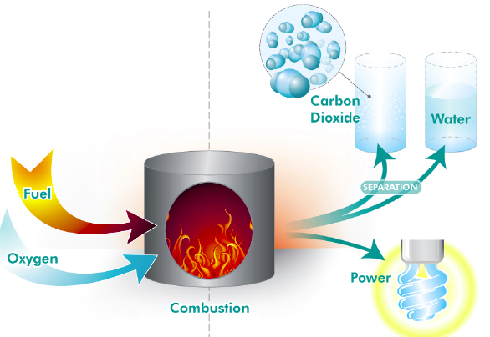
Capture: Oxyfuel
Conventional (or new designs) power station boilers burn pulverised coal in pure oxygen to fuel a steam generator, creating an exhaust mixture of highly concentrated CO₂ and water vapor. The concentrated CO₂ is easier & cheaper to capture.
Notes:
Carbon Capture Research
Before carbon dioxide (CO2) gas can be sequestered from power plants and other point sources, it must be captured as a relatively pure gas. On a mass basis, CO2 is the 19th largest commodity chemical in the United States, and CO2 is routinely separated and captured as a by-product from industrial processes such as synthetic ammonia production, H2 production, and limestone calcination.
Existing capture technologies, however, are not cost-effective when considered in the context of sequestering CO2 from power plants. Most power plants and other large point sources use air-fired combustors, a process that exhausts CO2 diluted with nitrogen. Flue gas from coal-fired power plants contains 10-12 percent CO2 by volume, while flue gas from natural gas combined cycle plants contains only 3-6 percent CO2. For effective carbon sequestration, the CO2 in these exhaust gases must be separated and concentrated.
CO2 is currently recovered from combustion exhaust by using amine absorbers and cryogenic coolers. The cost of CO2 capture using current technology, however, is on the order of $150 per ton of carbon - much too high for carbon emissions reduction applications. Analysis performed by SFA Pacific, Inc. indicates that adding existing technologies for CO2 capture to an electricity generation process could increase the cost of electricity by 2.5 cents to 4 cents/kWh depending on the type of process.
Furthermore, carbon dioxide capture is generally estimated to represent three-fourths of the total cost of a carbon capture, storage, transport, and sequestration system.
The program is pursuing evolutionary improvements in existing CO2 capture systems and also exploring revolutionary new capture and sequestration concepts. The most likely options currently identifiable for CO2 separation and capture include:
Absorption (chemical and physical)
Adsorption (physical and chemical)
Low-temperature distillation
Gas separation membranes
Mineralization and biomineralization
Opportunities for significant cost reductions exist since very little R&D has been devoted to CO2 capture and separation technologies. Several innovative schemes have been proposed that could significantly reduce CO2 capture costs, compared to conventional processes. "One box" concepts that combine CO2 capture with reduction of criteria pollutant emissions are being explored as well.
Examples of activities for this program element include:
Research on revolutionary improvements in CO2 separation and capture technologies
new materials (e.g., physical and chemical absorbents, carbon fiber molecular sieves, polymeric membranes);
micro-channel processing units with rapid kinetics;
CO2 hydrate formation and separation processes;
oxygen-enhanced combustion approaches;
Development of retrofittable CO2 reduction and capture options for existing large point sources of CO2 emissions such as electricity generation units, petroleum refineries, and cement and lime production facilities;
Integration of CO2 capture with advanced power cycles and technologies and with environmental control technologies for criteria pollutants.
http://www.fossil.energy.gov/programs/sequestration

Slide 39
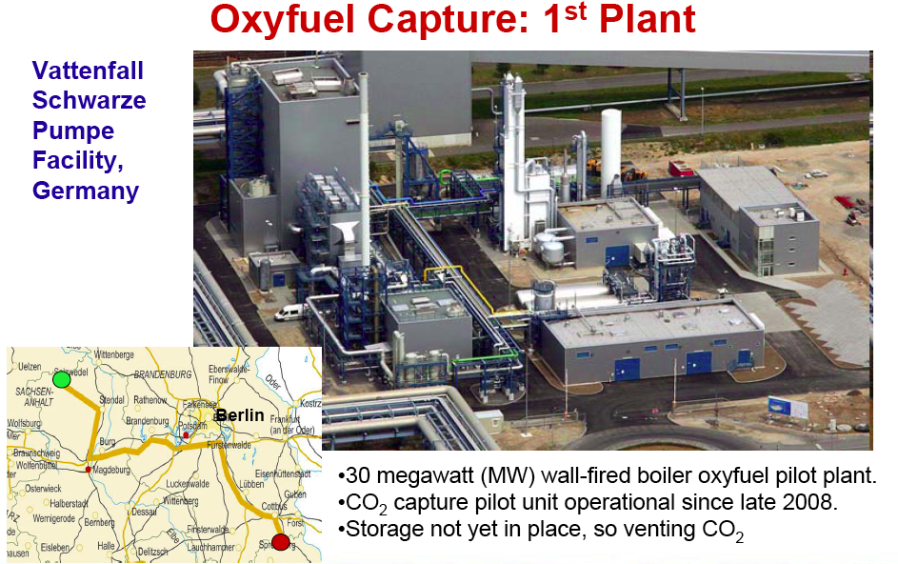
Notes:
Carbon Capture Research
Before carbon dioxide (CO2) gas can be sequestered from power plants and other point sources, it must be captured as a relatively pure gas. On a mass basis, CO2 is the 19th largest commodity chemical in the United States, and CO2 is routinely separated and captured as a by-product from industrial processes such as synthetic ammonia production, H2 production, and limestone calcination.
Existing capture technologies, however, are not cost-effective when considered in the context of sequestering CO2 from power plants. Most power plants and other large point sources use air-fired combustors, a process that exhausts CO2 diluted with nitrogen. Flue gas from coal-fired power plants contains 10-12 percent CO2 by volume, while flue gas from natural gas combined cycle plants contains only 3-6 percent CO2. For effective carbon sequestration, the CO2 in these exhaust gases must be separated and concentrated.
CO2 is currently recovered from combustion exhaust by using amine absorbers and cryogenic coolers. The cost of CO2 capture using current technology, however, is on the order of $150 per ton of carbon - much too high for carbon emissions reduction applications. Analysis performed by SFA Pacific, Inc. indicates that adding existing technologies for CO2 capture to an electricity generation process could increase the cost of electricity by 2.5 cents to 4 cents/kWh depending on the type of process.
Furthermore, carbon dioxide capture is generally estimated to represent three-fourths of the total cost of a carbon capture, storage, transport, and sequestration system.
The program is pursuing evolutionary improvements in existing CO2 capture systems and also exploring revolutionary new capture and sequestration concepts. The most likely options currently identifiable for CO2 separation and capture include:
Absorption (chemical and physical)
Adsorption (physical and chemical)
Low-temperature distillation
Gas separation membranes
Mineralization and biomineralization
Opportunities for significant cost reductions exist since very little R&D has been devoted to CO2 capture and separation technologies. Several innovative schemes have been proposed that could significantly reduce CO2 capture costs, compared to conventional processes. "One box" concepts that combine CO2 capture with reduction of criteria pollutant emissions are being explored as well.
Examples of activities for this program element include:
Research on revolutionary improvements in CO2 separation and capture technologies
new materials (e.g., physical and chemical absorbents, carbon fiber molecular sieves, polymeric membranes);
micro-channel processing units with rapid kinetics;
CO2 hydrate formation and separation processes;
oxygen-enhanced combustion approaches;
Development of retrofittable CO2 reduction and capture options for existing large point sources of CO2 emissions such as electricity generation units, petroleum refineries, and cement and lime production facilities;
Integration of CO2 capture with advanced power cycles and technologies and with environmental control technologies for criteria pollutants.
http://www.fossil.energy.gov/programs/sequestration

Slide 40
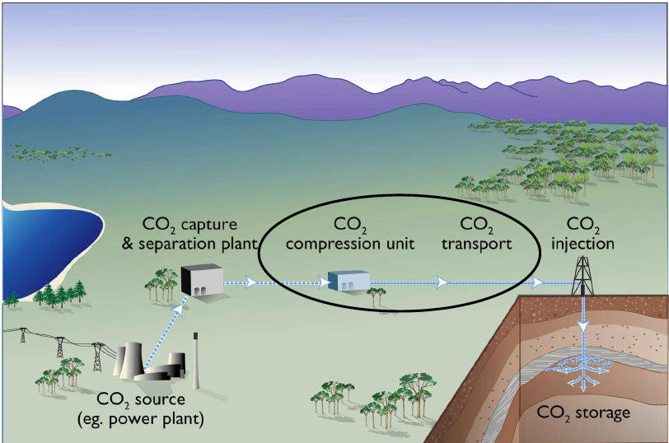
Compressing & Transporting CO2
Notes:
Developing Cleaner Coal Technologies
Carbon sequestration is a family of methods for capturing and permanently isolating carbon dioxide. Sequestration of carbon dioxide emissions from coal could help retain coal’s strategic value as a low-cost, abundant, domestic fuel.
The 2006 Budget provides $286 million for the President’s Coal Research Initiative to improve the environmental performance of coal power plants by reducing emissions and improving efficiency. This includes $68 million for the Clean Coal Power Initiative, of which $18 million is allocated to continue development of the FutureGen coal-fueled, zero-emissions, electricity and hydrogen generation project announced by the President in February 2003. FutureGen is guided by an industry and international partnership that will work cooperatively on research, development, and deployment of technologies that will dramatically reduce air pollution from coal-fueled electricity generation plants, generate hydrogen, and capture and store greenhouse gas emissions. The Budget ensures that unexpended funds available from prior years’ clean coal projects are available to fund future clean coal activities, beginning with FutureGen. The Budget also increases funding for research and development of other clean coal technologies, such as Integrated Gasification Combined Cycle systems, carbon sequestration, and next-generation turbines.

Slide 41
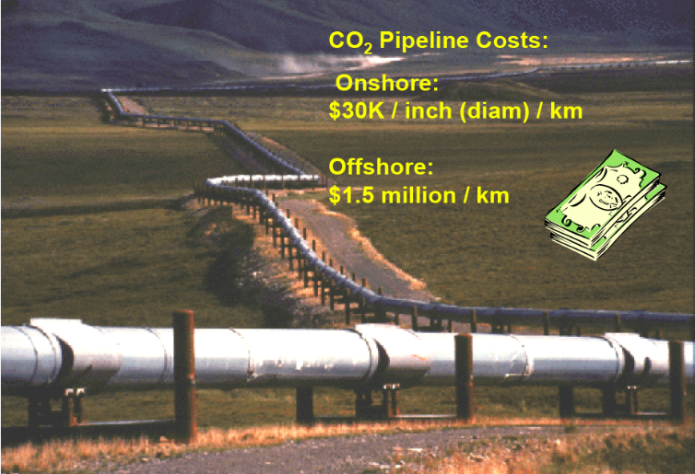
Compressing & Transporting CO2
Notes:
On shore: 1 million/km
Developing Cleaner Coal Technologies
Carbon sequestration is a family of methods for capturing and permanently isolating carbon dioxide. Sequestration of carbon dioxide emissions from coal could help retain coal’s strategic value as a low-cost, abundant, domestic fuel.
The 2006 Budget provides $286 million for the President’s Coal Research Initiative to improve the environmental performance of coal power plants by reducing emissions and improving efficiency. This includes $68 million for the Clean Coal Power Initiative, of which $18 million is allocated to continue development of the FutureGen coal-fueled, zero-emissions, electricity and hydrogen generation project announced by the President in February 2003. FutureGen is guided by an industry and international partnership that will work cooperatively on research, development, and deployment of technologies that will dramatically reduce air pollution from coal-fueled electricity generation plants, generate hydrogen, and capture and store greenhouse gas emissions. The Budget ensures that unexpended funds available from prior years’ clean coal projects are available to fund future clean coal activities, beginning with FutureGen. The Budget also increases funding for research and development of other clean coal technologies, such as Integrated Gasification Combined Cycle systems, carbon sequestration, and next-generation turbines.

Slide 42
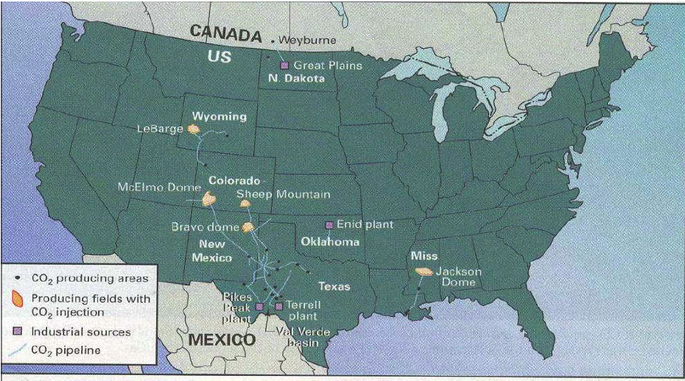
Over 5000 km of supercritical CO2 pipelines in US ALREADY!
Notes:
CO2 enhanced oil extraction, injected to push oil out
Developing Cleaner Coal Technologies
Carbon sequestration is a family of methods for capturing and permanently isolating carbon dioxide. Sequestration of carbon dioxide emissions from coal could help retain coal’s strategic value as a low-cost, abundant, domestic fuel.
The 2006 Budget provides $286 million for the President’s Coal Research Initiative to improve the environmental performance of coal power plants by reducing emissions and improving efficiency. This includes $68 million for the Clean Coal Power Initiative, of which $18 million is allocated to continue development of the FutureGen coal-fueled, zero-emissions, electricity and hydrogen generation project announced by the President in February 2003. FutureGen is guided by an industry and international partnership that will work cooperatively on research, development, and deployment of technologies that will dramatically reduce air pollution from coal-fueled electricity generation plants, generate hydrogen, and capture and store greenhouse gas emissions. The Budget ensures that unexpended funds available from prior years’ clean coal projects are available to fund future clean coal activities, beginning with FutureGen. The Budget also increases funding for research and development of other clean coal technologies, such as Integrated Gasification Combined Cycle systems, carbon sequestration, and next-generation turbines.

Slide 43
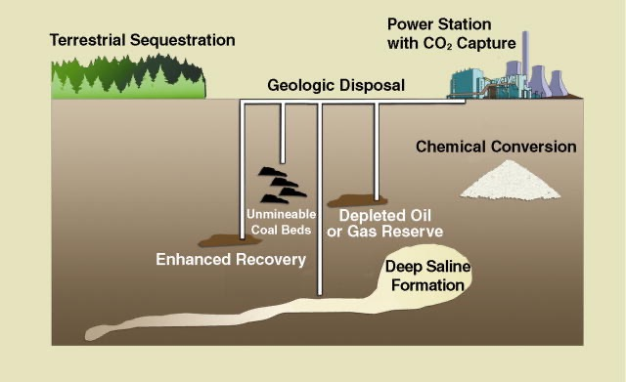
Carbon Storage/Sequestration Options
Notes:
Developing Cleaner Coal Technologies
Carbon sequestration is a family of methods for capturing and permanently isolating carbon dioxide. Sequestration of carbon dioxide emissions from coal could help retain coal’s strategic value as a low-cost, abundant, domestic fuel.
The 2006 Budget provides $286 million for the President’s Coal Research Initiative to improve the environmental performance of coal power plants by reducing emissions and improving efficiency. This includes $68 million for the Clean Coal Power Initiative, of which $18 million is allocated to continue development of the FutureGen coal-fueled, zero-emissions, electricity and hydrogen generation project announced by the President in February 2003. FutureGen is guided by an industry and international partnership that will work cooperatively on research, development, and deployment of technologies that will dramatically reduce air pollution from coal-fueled electricity generation plants, generate hydrogen, and capture and store greenhouse gas emissions. The Budget ensures that unexpended funds available from prior years’ clean coal projects are available to fund future clean coal activities, beginning with FutureGen. The Budget also increases funding for research and development of other clean coal technologies, such as Integrated Gasification Combined Cycle systems, carbon sequestration, and next-generation turbines.

Slide 44
Types of Carbon Sequestration
Geologic Sequestration
Ocean Sequestration
Terrestrial Sequestration
Novel Sequestration Concepts
http://www.fossil.energy.gov/programs/sequestration
Notes:
Geologic: under ground
Terrestrial: plant and soil

Slide 45
Geologic Sequestration
Porous rock bodies surrounded by impermeable rock are ideal for CO₂ storage
Oil and gas reservoirs
  Inject CO₂ to improve recovery
Coal bed methane
  Inject CO₂ into coal seams to extract methane
Inject into deep saline (salt) formations
  No direct economic benefit
http://www.fossil.energy.gov/programs/sequestration
Notes:
Geologic Sequestration Research
Carbon dioxide sequestration in geologic formations includes oil and gas reservoirs, unmineable coal seams, and deep saline reservoirs. These are structures that have stored crude oil, natural gas, brine and CO2 over millions of years. Many power plants and other large emitters of CO2 are located near geologic formations that are amenable to CO2 storage. Further, in many cases, injection of CO2 into a geologic formation can enhance the recovery of hydrocarbons, providing value-added byproducts that can offset the cost of CO2 capture and sequestration.
The primary goal of the Energy Department's sequestration research is to understand the behavior of CO2 when stored in geologic formations. For example, studies are being done to determine the extent to which the CO2 moves within the geologic formation, and what physical and chemical changes occur to the formation when CO2 is injected. This information is key to ensure that sequestration will not impair the geologic integrity of an underground formation and that CO2 storage is secure and environmentally acceptable.
Oil and Gas Reservoirs. In some cases, production from an oil or natural gas reservoir can be enhanced by pumping CO2 gas into the reservoir to push out the product, which is called enhanced oil recovery. The United States is the world leader in enhanced oil recovery technology, using about 32 million tons of CO2 per year for this purpose. From the perspective of the sequestration program, enhanced oil recovery represents an opportunity to sequester carbon at low net cost, due to the revenues from recovered oil/gas.
In an enhanced oil recovery application, the integrity of the CO2 that remains in the reservoir is well-understood and very high, as long as the original pressure of the reservoir is not exceeded. The scope of this EOR application is currently economically limited to point sources of CO2 emissions that are near an oil or natural gas reservoir.
Coal Bed Methane. Coal beds typically contain large amounts of methane-rich gas that is adsorbed onto the surface of the coal. The current practice for recovering coal bed methane is to depressurize the bed, usually by pumping water out of the reservoir. An alternative approach is to inject carbon dioxide gas into the bed. Tests have shown that the adsorption rate for CO2 to be approximately twice that of methane, giving it the potential to efficiently displace methane and remain sequestered in the bed. CO2 recovery of coal bed methane has been demonstrated in limited field tests, but much more work is necessary to understand and optimize the process.
Similar to the by-product value gained from enhanced oil recovery, the recovered methane provides a value-added revenue stream to the carbon sequestration process, creating a low net cost option. The U.S. coal resources are estimated at 6 trillion tons, and 90 percent of it is unmineable due to seam thickness, depth, and structural integrity. Another promising aspect of CO2 sequestration in coal beds is that many of the large unmineable coal seams are near electricity generating facilities that are large point sources of CO2 gas. Thus, limited pipeline transport of CO2 gas would be required. Integration of coal bed methane with a coal-fired electricity generating system can provide an option for additional power generation with low emissions.
Saline Formations. Sequestration of CO2 in deep saline formations does not produce value-added by-products, but it has other advantages. First, the estimated carbon storage capacity of saline formations in the United States is large, making them a viable long-term solution. It has been estimated that deep saline formations in the United States could potentially store up to 500 billion tonnes of CO2.
Second, most existing large CO2 point sources are within easy access to a saline formation injection point, and therefore sequestration in saline formations is compatible with a strategy of transforming large portions of the existing U.S. energy and industrial assets to near-zero carbon emissions via low-cost carbon sequestration retrofits.
Assuring the environmental acceptability and safety of CO2 storage in saline formations is a key component of this program element. Determining that CO2 will not escape from formations and either migrate up to the earth’s surface or contaminate drinking water supplies is a key aspect of sequestration research. Although much work is needed to better understand and characterize sequestration of CO2 in deep saline formations, a significant baseline of information and experience exists. For example, as part of enhanced oil recovery operations, the oil industry routinely injects brines from the recovered oil into saline reservoirs, and the U.S. Environmental Protection Agency (EPA) has permitted some hazardous waste disposal sites that inject liquid wastes into deep saline formations.
The Norwegian oil company, Statoil, is injecting approximately one million tonnes per year of recovered CO2 into the Utsira Sand, a saline formation under the sea associated with the Sleipner West Heimdel gas reservoir. The amount being sequestered is equivalent to the output of a 150-megawatt coal-fired power plant.
http://www.fossil.energy.gov/programs/sequestration
___________________________________________________
Geologic formations considered for CO2 storage are layers of porous rock deep underground that are “capped” by a layer of non-porous rock above them. Sequestration practitioners drill a well down into the porous rock and inject pressurized CO2 into it. The CO2 is buoyant and flows upward until it encounters the layer of non-porous rock and becomes trapped. There are other mechanisms for CO2 trapping as well. CO2 molecules can dissolve in brine, react with minerals to form solid carbonates, or adsorb in the pores of the porous rock. The degree to which a specific underground formation is amenable to CO2 storage can be difficult to discern. Research is aimed at developing the ability to characterize a formation before CO2-injection to be able to predict its CO2 storage capacity. Another area of research is the development of CO2 injection techniques that achieve broad dispersion of CO2 throughout the formation, overcome low diffusion rates, and avoid fracturing the cap rock. These two areas, site characterization and injection techniques, are interrelated because improved formation characterization will help determine the best injection procedure.
There are three priority types of geologic formations in which CO2 can be stored, and each has different opportunities and challenges:
Depleted oil and gas reservoirs. These are formations that held crude oil and natural gas over geologic time frames. In general they are a layer of porous rock with a layer of non-porous rock above such that the non-porous layer forms a dome. It is the dome shape that trapped the hydrocarbons. This same dome offers great potential to trap CO2 and makes these formations excellent sequestration opportunities.
As a value-added benefit, CO2 injected into a depleting oil reservoir can enable incremental oil to be recovered. The CO2 lowers the viscosity of the oil enabling it to slip through the pores in the rock and flow with the pressure differential toward a recovery well. Typically, primary oil recovery and secondary recovery via a water flood produce 30-40% of a reservoir's original oil in place (OOIP). A CO2 flood enables recovery of an additional 10-15% of the OOIP. CO2 enhanced oil recovery (EOR) is a commercial process and in demand recently with high crude oil prices. However, commercial practitioners operate their injections with the goal of minimizing the amount of CO2 left in the ground so that the CO2 can be used for another well. NETL's work in this area is focused on CO2 EOR injection practices that maximize the amount of CO2 sequestered.
Unmineable coal seams. Unmineable coal seams are too deep or too thin to be mined economically. All coals have varying amounts of methane adsorbed onto pore surfaces, and wells can be drilled into unmineable coal beds to recover this coal bed methane (CBM ). Initial CBM recovery methods, dewatering and depressurization, leave a fair amount of CBM in the reservoir. Additional CBM recovery can be achieved by sweeping the coalbed with nitrogen. CO2 offers an alternative to nitrogen. It preferentially adsorbs onto the surface of the coal, releasing the methane. Two or three molecules of CO2 are adsorbed for each molecule of methane released, thereby providing an excellent storage sink for CO2. The maximum domestic capacity for CO2 enhanced coalbed methane (ECBM) has been estimated at 90 billion metric tons CO2,* 40 billion metric tons of which are in Alaska . Like depleting oil reservoirs, unmineable coal beds are a good early opportunity for CO2 storage.
Coal swelling is a potential barrier to CO2 ECBM. It has been observed that when coal adsorbs CO2, it swells in volume. In an underground formation swelling can cause a sharp drop in permeability, which not only restricts the flow of CO2 into the formation but also impedes the recovery of displaced CBM. NETL is pursuing angled drilling techniques and fracturing as possible means of overcoming the negative effects of swelling.
Saline formations. Saline formations are layers of porous rock that are saturated with brine. They are much more commonplace than coal seams or oil and gas bearing rock, and represent an enormous potential for CO2 storage capacity. However, much less is known about saline formations than is known about crude oil reservoirs and coal seams and there is a greater amount of uncertainty associated with their amenability to CO2 storage.
Saline formations tend to have a lower permeability than do hydrocarbon-bearing formations, and work is directed at hydraulic fracturing and other field practices to increase injectivity. Saline formations contain minerals that could react with injected CO2 to form solid carbonates. The carbonate reactions have the potential to be both a positive and a negative. They can increase permanence but they also may plug up the formation in the immediate vicinity of an injection well. Researchers seek injection techniques that promote advantageous mineralization reactions.
http://www.netl.doe.gov/technologies/carbon_seq/core_rd/storage.html

Slide 46
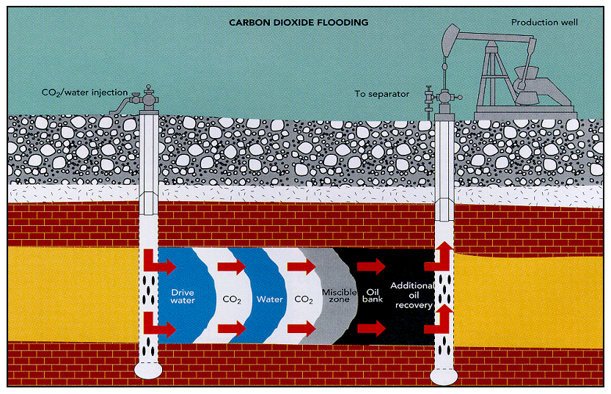
Geologic Sequestration
http://www.midcarb.org/Graphics/CO2flooding.gif

Slide 47
Ocean Sequestration
Ice-like CO₂/H₂O (water) hydrates
  Form in the deep ocean at low temperatures and high pressures
Oceans will naturally absorb 80-90% of CO₂ in atmosphere
  Eventually transferred to deep ocean
  Too slow to prevent CO₂ spike in next 100 years
Research investigating direct injection of CO₂ into the deep ocean
http://www.fossil.energy.gov/programs/sequestration
Notes:
Ocean Sequestration Research
MORE INFO
National Lab scientists at DOE's Center for Research on Ocean Carbon Sequestration are studying deep injection and ocean fertilization.
[Leave site]
CO2 is soluble in ocean water, and through natural processes the oceans both absorb and emit huge amounts of CO2 into the atmosphere. In fact, the amount of carbon stored in the ocean dwarfs the carbon stored in terrestrial ecosystems.
It is widely believed that the oceans will eventually absorb 80-90 percent of the CO2 in the atmosphere and transfer it to the deep ocean. However, the kinetics of ocean uptake are unacceptably slow, causing a peak atmospheric CO2 concentration of several hundred years.The program will explore options for speeding up the natural processes by which the oceans transport CO2 and for injecting CO2 directly into the deep ocean.
Enhancement of Natural Carbon Sequestration in the Ocean
One approach to enhancing export production of carbon to the deep ocean is via the addition of iron chelates (a micronutrient) to high nutrient, low chlorophyll (HNLC) regions, in order to increase the drawdown of CO2 as a result of stimulated phytoplankton blooms. Another related technique would be the addition of nitrates and phosphorus (macronutrients) to low nutrient, low chlorophyll (LNLC) ocean regions. The magnitude of these enhancements to the biological pump and the depth of vertical transport are unknown, and require additional research, as well as investigation into unknown biological consequences from such perturbations, e.g., eutrophication, or increasing number of unwanted events (toxic blooms).
Direct Injection of CO2
Technology currently exists to perform the direct injection of CO2 into the deep ocean. However,the knowledge base is inadequate to determine what biological, physical or chemical impacts might occur from interaction of this hydrate plume with the marine ecosystem. Additionally, there is insufficient information to perform any process optimization pertaining to costs and engineering activities.
To assure environmental acceptability, developing a better understanding of the ecological impacts of both ocean fertilization and direct injection of CO2 into the deep ocean is a primary focus of this program element. It is known that small changes in biogeochemical cycles may have large consequences, many of which are secondary and difficult to predict. Of particular concern is the potential for adverse effects due to localized depressed pH, and elevated localized CO2 concentrations (hypercapnia).
http://www.fossil.energy.gov/programs/sequestration
______________________________________________________
Compared to terrestrial ecosystems and geologic formations, the concept of ocean sequestration is in a much earlier stage of development. The ocean has huge potential as a carbon storage sink, but the scientific understanding to enable ocean sequestration to be considered as a real option is not yet available. A small level of funding is provided to leading researchers in this area to develop the necessary scientific understanding of the feasibility of ocean sequestration. Work is focused on understanding the mechanisms of CO2 uptake in the ocean and assessing the environmental impacts of CO2 storage. NETL is also funding laboratory studies of the behavior of CO2 droplets and CO2/water hydrate structures in simulated ocean environments.

Slide 48
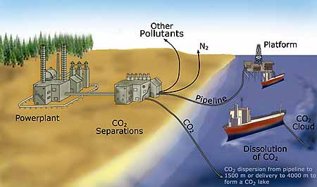
Ocean Sequestration
http://www.lbl.gov/Science-Articles/Archive/sea-carb-bish.html
Notes:
One of the most promising places to sequester carbon is in the oceans, which currently take up a third of the carbon emitted by human activity, roughly two billion metric tons each year. The amount of carbon that would double the load in the atmosphere would increase the concentration in the deep ocean by only two percent. Two sequestration strategies are under intense study at the Department of Energy's Center for Research on Ocean Carbon Sequestration (DOCS), where Jim Bishop of Berkeley Lab's Earth Sciences Division is codirector with Livermore Lab's Ken Caldeira. One is direct injection, which would pump liquefied carbon dioxide a thousand meters deep or deeper, either directly from shore stations or from tankers trailing long pipes at sea.
"At great depths, CO2 is denser than sea water, and it may be possible to store it on the bottom as liquid or deposits of icy hydrates," Bishop explains. "At depths easy to reach with pipes, CO2 is buoyant; it has to be diluted and dispersed so it will dissolve."
What happens to carbon dioxide introduced into the ocean in this way may soon be field-tested in Hawaii. Over a two-week period researchers plan to inject 40 to 60 metric tons of pure liquid CO2 over 2,500 feet deep in the ocean near the Big Island.
One variable they will be measuring is acidity. Water and carbon dioxide form carbonic acid, "but once diluted in sea water, carbonic acid is not the dominant chemical species," Bishop says, "because of seawater's high alkalinity and buffering capacity." If calcium carbonate sediments are involved, acidity is even less. "Think of Tums," he suggests.
Fertilizing the ocean
The other major approach to sequestration is to "prime the biological pump" by fertilizing the ocean. Near the surface, carbon is fixed by plant-like phytoplankton, which are eaten by sea animals; some eventually rains down as waste and dead organisms. Bacteria feed on this particulate organic carbon and produce CO2, which dissolves, while the rest of the detritus ends on the sea floor.
"There are areas of the ocean that are rich in nutrients like nitrogen and phosphorus but poor in phytoplankton," says Bishop. "Adding a little iron to the mix allows the plankton to use the nutrients and bloom. The energy for the process is supplied by sunlight. Already commercial outfits are dropping iron filings overboard, hoping to increase fisheries -- meanwhile claiming they are helping to prevent global warming."
THE GLOBAL CARBON CYCLE AND THE ROLE OF THE OCEAN
In fact, Bishop explains, "if the excess fixed carbon in plants is eaten by fish near the ocean surface, the net effect is no gain. And in every part of the ocean there are open mouths."
No one really knows where the carbon trapped by fertilization ends up. In one iron-fertilization experiment in warm equatorial waters, chlorophyll increased 30-fold in a week, and there was increased carbon sedimentation down through 100 meters. But the bloom shortly dissipated, the fate of the carbon in deeper waters wasn't followed, and long-term effects weren't measured.
In a more recent experiment in cold Antarctic Ocean waters the plankton bloom persisted much longer. Seven weeks after the experiment ended a distinct pattern of iron-fertilized plankton was still visible from space -- "which means the fixed carbon was still at the surface."
Bishop says that "people who want to add iron think the particulate matter will fall straight to the bottom; I have sampled natural plankton blooms, and I have not seen that happen. These guys have a potentially effective method of sequestering carbon, but as yet there is no scientific basis for their claims."

Slide 49
Terrestrial Sequestration
Forest lands.
  Below-ground carbon and long-term management and utilization of standing stocks, understory, ground cover, and litter.
Agricultural lands.
  Crop lands, grasslands, and range lands
  Emphasis on increasing long-lived soil carbon.
Biomass croplands
  Increase soil carbon and value-added organic products
  Complement to ongoing efforts related to biofuels
Deserts and degraded lands
  Restoration of degraded lands significant benefits and carbon sequestration potential in both below-and above-ground systems.
Boreal wetlands and peatlands
  Soil carbon pools
  Limited conversion to forest or grassland where ecologically acceptable.
http://www.netl.doe.gov/technologies/carbon_seq/core_rd/storage.html
Notes:
1-4 tons CO2 per acre per year
errestrial
15% soil carbon in wetland peatland
Sequestration Research
Vegetation and soils are widely recognized as carbon storage sinks. The global biosphere absorbs roughly 2 billion tons of carbon annually, an amount equal to roughly one third of all global carbon emissions from human activity. Significant amounts of this carbon remains stored in the roots of certain plants and in the soil. In fact, the inventory of carbon stored in the global ecosystem equals rougly 1,000 years worth of annual absorption, or 2 trillion tons of carbon.
Another important area of research in terrestrial sequestration is the development of technologies for quantifying carbon stored in a given ecosystem. Should the United States and other nations one day adopt a carbon emissions trading program, high precisions and reliability in these measuring techniques will be necessary.
Terrestrial carbon sequestration is defined as either the net removal of CO2 from the atmosphere or the prevention of CO2 net emissions from the terrestrial ecosystems into the atmosphere.
Enhancing the natural processes that remove CO2 from the atmosphere is thought to be one of the most cost-effective means of reducing atmospheric levels of CO2, and forestation and deforestation abatement efforts are already under way. R&D in this program area seeks to increase this rate while properly considering all the ecological, social, and economic implications. There are two fundamental approaches to sequestering carbon in terrestrial ecosystems: (1) protection of ecosystems that store carbon so that carbon stores can be maintained or increased; and (2) manipulation of ecosystems to increase carbon sequestration beyond current conditions.
This program area is focused on integrating measures for improving the full life-cycle carbon uptake of terrestrial ecosystems,including farmland and forests,with fossil fuel production and use. The following ecosystems offer significant opportunity for carbon sequestration:
Forest lands. The focus includes below-ground carbon and long-term management and utilization of standing stocks,understory, ground cover,and litter.
Agricultural lands. The focus includes crop lands, grasslands, and range lands,with emphasis on increasing long-lived soil carbon.
Biomass croplands. As a complement to ongoing efforts related to biofuels,the focus is on long-term increases in soil carbon and value-added organic products.
Deserts and degraded lands. Restoration of degraded lands offers significant benefits and carbon sequestration potential in both below-and above-ground systems.
Boreal wetlands and peatlands. The focus includes management of soil carbon pools and perhaps limited conversion to forest or grassland vegetation where ecologically acceptable.
The program area is being conducted in collaboration with DOE’s Office of Science and the U.S.Forest Service of the U.S. Department of Agriculture.
______________________________________
Terrestrial sequestration is the enhancement of the CO2 uptake by plants that grow on land and in freshwater and, importantly, the enhancement of carbon storage in soils where it may remain more permanently stored. Terrestrial sequestration provides an opportunity for low-cost CO2 emissions offsets. Early efforts include tree-plantings, no till farming, and forest preservation. More advanced research includes the development of fast-growing trees and grasses and deciphering the genomes of carbon-storing soil microbes. Responsibility for terrestrial sequestration research is shared by many Federal agencies, and the program coordinates activities in this area with the DOE Office of Science, U.S. Department of Agriculture, U.S. Environmental Protection Agency, and U.S. Department of Interior Office of Surface Mining. The scope of terrestrial sequestration options addressed in NETL's core R&D is limited to the integration of energy production, conversion, and use with land reclamation. Specifically, this involves the reforestation and amendment of minelands and other damaged soils, when possible, using solid residuals from coal combustion.
http://www.netl.doe.gov/technologies/carbon_seq/core_rd/storage.html

Slide 50
Novel CS Concepts
Advanced catalysts for CO₂ or CO conversion;
Novel solvents, sorbents, membranes, and thin films for gas separation;
Engineered photosynthesis systems;
Non-photosynthetic mechanisms for CO₂ fixation (methanogenesis and acetogenesis);
Genetic manipulation of agricultural and tree to enhance CO₂ sequestering potential;
Advanced decarbonization systems; and
Biomimetic systems.
http://www.fossil.energy.gov/programs/sequestration

Slide 51
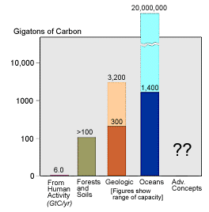
Carbon Sequestration
http://www.fossil.energy.gov/programs/sequestration

Slide 52
Hydrogen as a Fuel Source
Brief overview of fuel cell concepts
Characteristics of hydrogen as a fuel
Fuel cells for transportation vehicles
Fuel cells for stationary distributed power
Notes:
Carbon capture and storage technologies allow emissions of carbon dioxide to be ‘captured’ and ‘stored’ i.e. they are removed from the exhaust gases of the power station (either from conventional combustion or from gasification), and stored in such a way that they do not enter the atmosphere – thus reducing global warming.
Carbon storage is not yet cost-effective, but the required technologies are already proven and have been used commercially in other areas such as the food industry and chemicals industry. The key is to bring the different elements together at an acceptable cost, and research is ongoing to achieve this goal.

Slide 53
Promise of Fuel Cells
“A score of non-utility companies are well advanced toward developing a powerful chemical fuel cell, which could sit in some hidden closet of every home silently ticking off electric power.”
  Theodore Levitt, “Marketing Myopia,” Harvard Business Review, 1960
Notes:
Carbon capture and storage technologies allow emissions of carbon dioxide to be ‘captured’ and ‘stored’ i.e. they are removed from the exhaust gases of the power station (either from conventional combustion or from gasification), and stored in such a way that they do not enter the atmosphere – thus reducing global warming.
Carbon storage is not yet cost-effective, but the required technologies are already proven and have been used commercially in other areas such as the food industry and chemicals industry. The key is to bring the different elements together at an acceptable cost, and research is ongoing to achieve this goal.

Slide 54
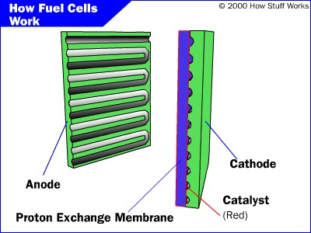
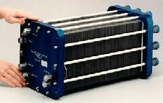
PEM Fuel Cell
Notes:
Carbon capture and storage technologies allow emissions of carbon dioxide to be ‘captured’ and ‘stored’ i.e. they are removed from the exhaust gases of the power station (either from conventional combustion or from gasification), and stored in such a way that they do not enter the atmosphere – thus reducing global warming.
Carbon storage is not yet cost-effective, but the required technologies are already proven and have been used commercially in other areas such as the food industry and chemicals industry. The key is to bring the different elements together at an acceptable cost, and research is ongoing to achieve this goal.

Slide 55
PEM Components
Anode: Negative post of the fuel cell.
  Conducts the electrons freed from the hydrogen molecules
  Etched channels disperse hydrogen gas over the surface of catalyst.
Cathode: Positive post of the fuel cell
  Etched channels distribute oxygen to the surface of the catalyst.
  Conducts electrons back from the external circuit to the catalyst
  Recombine with the hydrogen ions and oxygen to form water.
Electrolyte
  Proton exchange membrane.
  Specially treated material, only conducts positively charged ions.
  Membrane blocks electrons.
Catalyst
  Special material that facilitates reaction of oxygen and hydrogen
  Usually platinum powder very thinly coated onto carbon paper or cloth.
  Rough & porous maximizes surface area exposed to hydrogen or oxygen
  Platinum-coated side of the catalyst faces the PEM.
Notes:
Carbon capture and storage technologies allow emissions of carbon dioxide to be ‘captured’ and ‘stored’ i.e. they are removed from the exhaust gases of the power station (either from conventional combustion or from gasification), and stored in such a way that they do not enter the atmosphere – thus reducing global warming.
Carbon storage is not yet cost-effective, but the required technologies are already proven and have been used commercially in other areas such as the food industry and chemicals industry. The key is to bring the different elements together at an acceptable cost, and research is ongoing to achieve this goal.

Slide 56
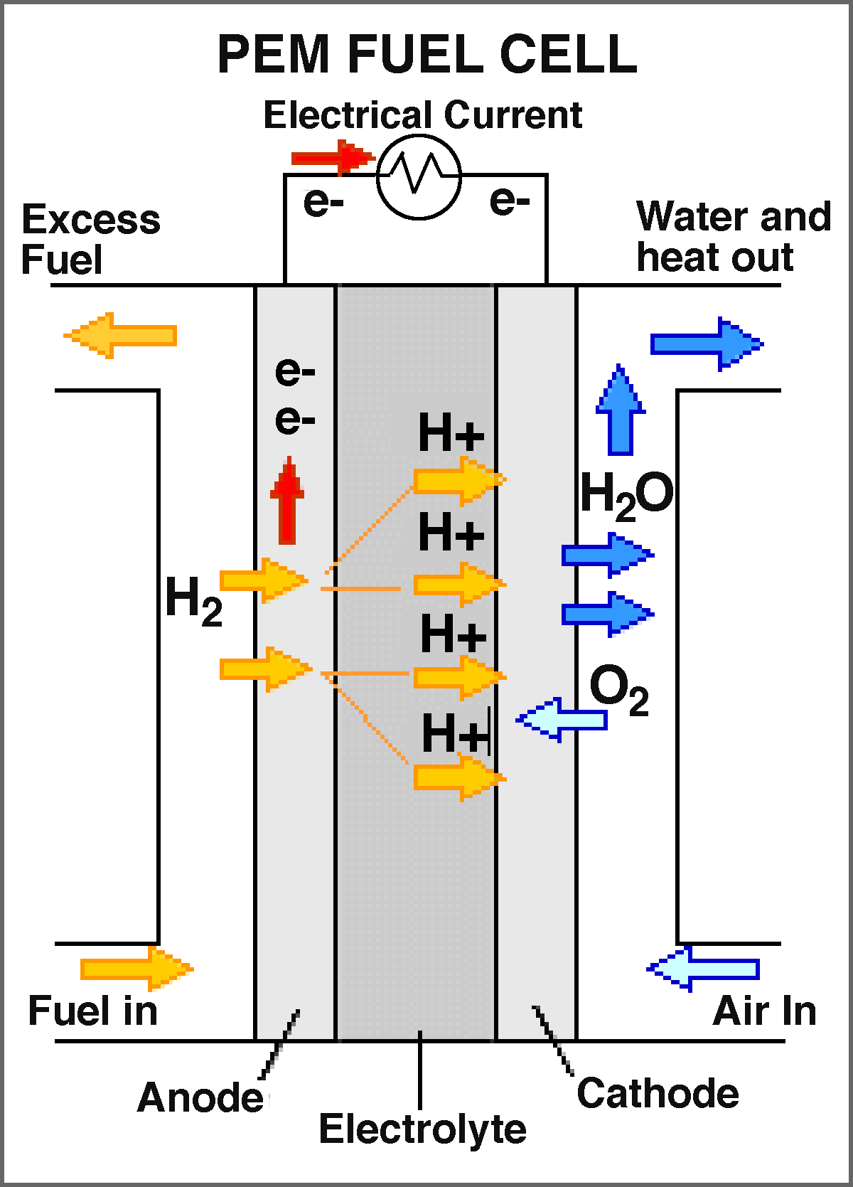
Fuel Cell Operation
Pressurized hydrogen gas (H₂) enters cell on anode side.
Gas is forced through catalyst by pressure.
  H₂ molecule splits into two H+ ions and two electrons (e-) on contact with platinum catalyst
Electrons are conducted through the anode through load (e.g., motor) and return cathode side of fuel cell
On the cathode side, oxygen gas (O₂) is forced through the catalyst
  Forms two oxygen atoms, each with a strong negative charge.
  Negative charge attracts the two H+ ions through the membrane,
  Combine with an oxygen atom and two electrons from the external circuit to form a water molecule (H₂O).
Notes:
Carbon capture and storage technologies allow emissions of carbon dioxide to be ‘captured’ and ‘stored’ i.e. they are removed from the exhaust gases of the power station (either from conventional combustion or from gasification), and stored in such a way that they do not enter the atmosphere – thus reducing global warming.
Carbon storage is not yet cost-effective, but the required technologies are already proven and have been used commercially in other areas such as the food industry and chemicals industry. The key is to bring the different elements together at an acceptable cost, and research is ongoing to achieve this goal.

Slide 57
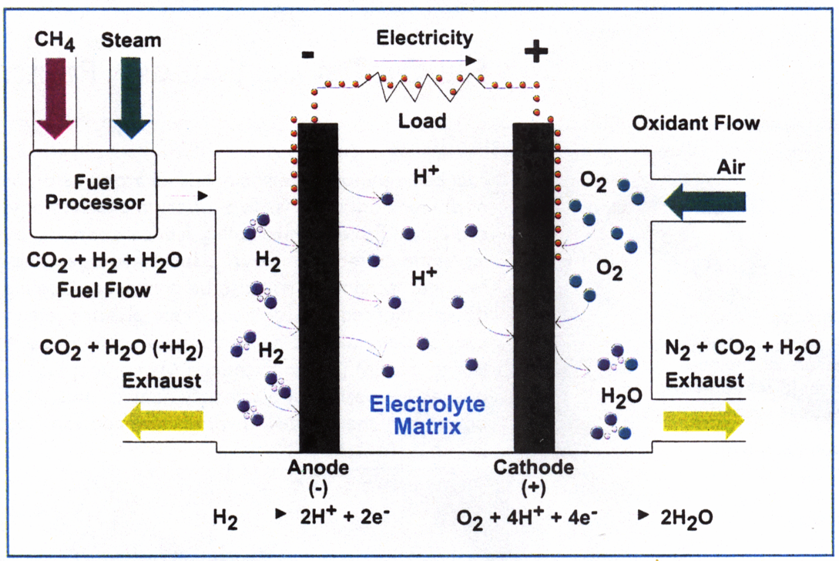
Methane as a Fuel Source
Notes:
Carbon capture and storage technologies allow emissions of carbon dioxide to be ‘captured’ and ‘stored’ i.e. they are removed from the exhaust gases of the power station (either from conventional combustion or from gasification), and stored in such a way that they do not enter the atmosphere – thus reducing global warming.
Carbon storage is not yet cost-effective, but the required technologies are already proven and have been used commercially in other areas such as the food industry and chemicals industry. The key is to bring the different elements together at an acceptable cost, and research is ongoing to achieve this goal.

Slide 58
Major Types of Fuel Cells
Efficiencies based on HHV and don’t include fuel reforming
Notes:
Carbon capture and storage technologies allow emissions of carbon dioxide to be ‘captured’ and ‘stored’ i.e. they are removed from the exhaust gases of the power station (either from conventional combustion or from gasification), and stored in such a way that they do not enter the atmosphere – thus reducing global warming.
Carbon storage is not yet cost-effective, but the required technologies are already proven and have been used commercially in other areas such as the food industry and chemicals industry. The key is to bring the different elements together at an acceptable cost, and research is ongoing to achieve this goal.

Slide 59
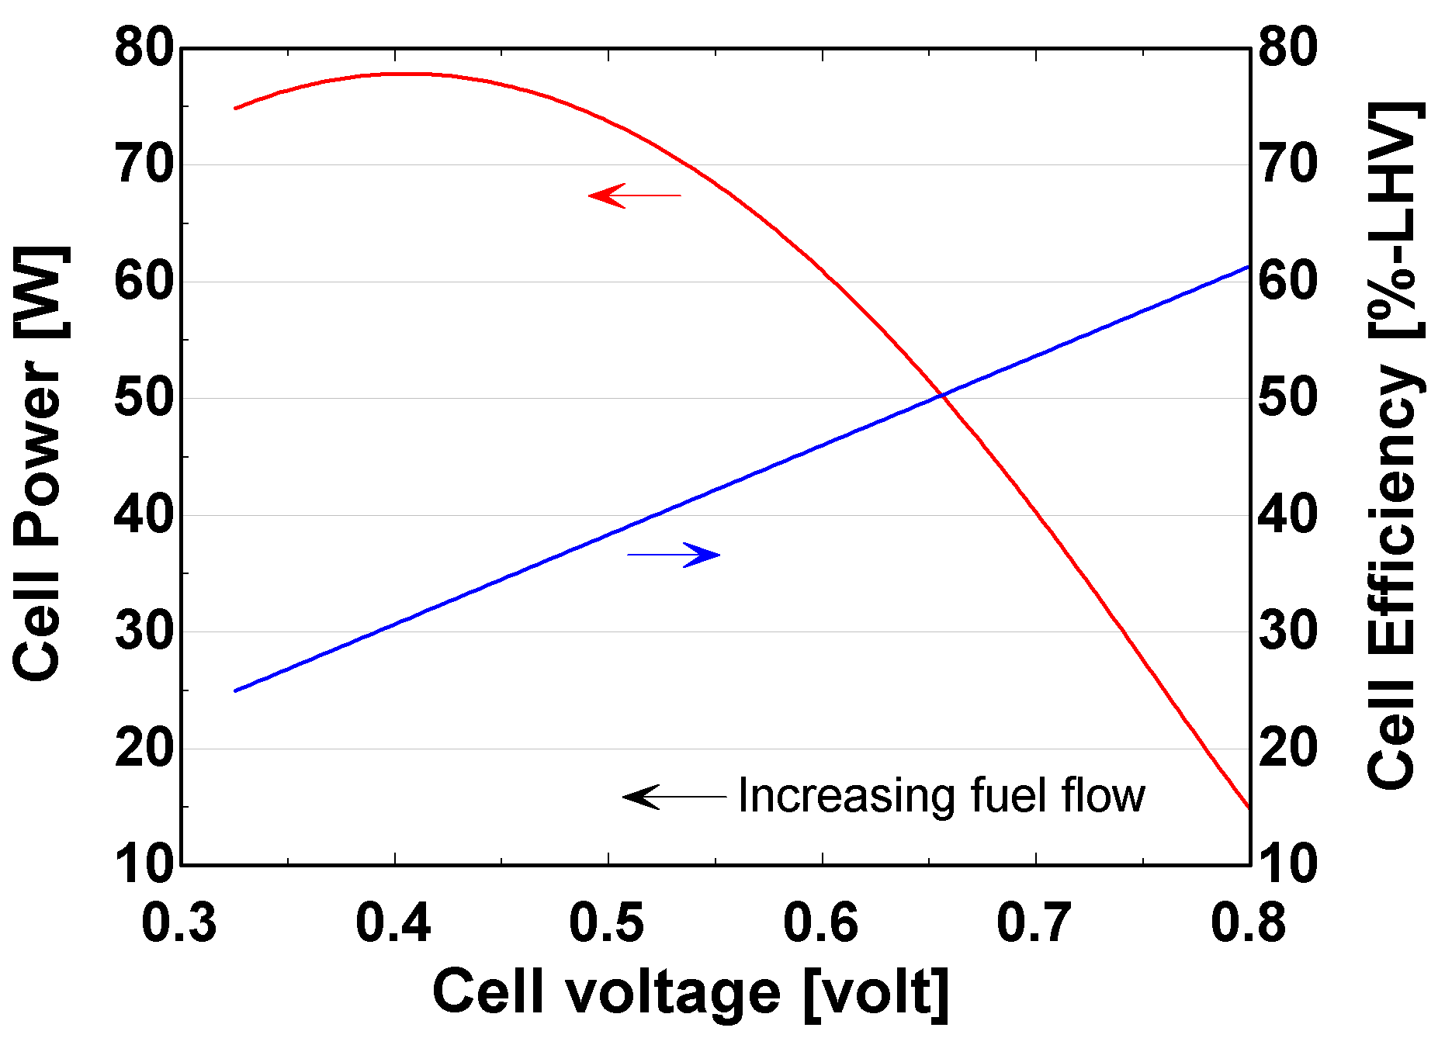
Fuel Cell Performance Characteristics
81 cm² SOFC
800°C
fuel util. = 85%
Higher power density: lower cell cost vs. cell cooling issues
Lower power density: lower parasitics vs. larger stacks (higher costs)
Notes:
Carbon capture and storage technologies allow emissions of carbon dioxide to be ‘captured’ and ‘stored’ i.e. they are removed from the exhaust gases of the power station (either from conventional combustion or from gasification), and stored in such a way that they do not enter the atmosphere – thus reducing global warming.
Carbon storage is not yet cost-effective, but the required technologies are already proven and have been used commercially in other areas such as the food industry and chemicals industry. The key is to bring the different elements together at an acceptable cost, and research is ongoing to achieve this goal.

Slide 60
Fuel Cell Technology Issues
Life: (Target = 40,000 hrs or ~5 yrs with <10% degradation)
  Reliability: Electrical shorts, catalyst performance, acid loss etc.
  Materials: corrosion, catalyst poisoning, sintering, etc.
Economics: (Target < $1,000 stationary, $50/kW transport.)
  Competition (microturbines, stationary engines)
  Lower costs needed for automotive - 100 hp (75 kW) →$75,000). Internal combustion engines are < $50/kW
Systems Integration
  Controls & integration with conventional equipment
Fuels: (Major reason for developmental delays)
  Reforming and associated efficiency/cost impacts
  Distribution and storage of H₂
Notes:
Carbon capture and storage technologies allow emissions of carbon dioxide to be ‘captured’ and ‘stored’ i.e. they are removed from the exhaust gases of the power station (either from conventional combustion or from gasification), and stored in such a way that they do not enter the atmosphere – thus reducing global warming.
Carbon storage is not yet cost-effective, but the required technologies are already proven and have been used commercially in other areas such as the food industry and chemicals industry. The key is to bring the different elements together at an acceptable cost, and research is ongoing to achieve this goal.

Slide 61
Characteristics of Hydrogen Fuel
Advantages of Hydrogen
Low to zero emissions
Compatible with all fuel cell types
Reduces dependence on imported petroleum (possibly)
Disadvantages of Hydrogen
Low energy storage density
Poor transport characteristics
Not naturally available
Hydrogen economy has been widely advocated
Notes:
Carbon capture and storage technologies allow emissions of carbon dioxide to be ‘captured’ and ‘stored’ i.e. they are removed from the exhaust gases of the power station (either from conventional combustion or from gasification), and stored in such a way that they do not enter the atmosphere – thus reducing global warming.
Carbon storage is not yet cost-effective, but the required technologies are already proven and have been used commercially in other areas such as the food industry and chemicals industry. The key is to bring the different elements together at an acceptable cost, and research is ongoing to achieve this goal.

Slide 62
How to Produce Hydrogen?
Electrolysis of water (4% of current production)
  Efficiency (η) is 70-80% (20-30% based on source energy)
  Electricity from: Wind, solar or nuclear energy
  DOE cost goal: $2.85/gal gasoline equiv. (1 kg H²) by 2010
Reformation of CH₄ (96% of current production)
  η ≈ 77%
  Endothermic
  CO₂ is still produced
  DOE cost goal: $1.50/gal gasoline equiv. by 2010
Other methods
  Biomass-derived
  Biological
  High temperature thermochemical e.g., ZnO reduction
Reforming: CH₄ + H₂O 3H₂ + CO (800°C ΔH = 206.16 kJ/mol CH₄)
Shift: CO + H₂O H₂ + CO₂
(300°C ΔH = -41.15 kJ/mol CO)
  http://www.eere.energy.gov/hydrogenandfuelcells/
Notes:
Carbon capture and storage technologies allow emissions of carbon dioxide to be ‘captured’ and ‘stored’ i.e. they are removed from the exhaust gases of the power station (either from conventional combustion or from gasification), and stored in such a way that they do not enter the atmosphere – thus reducing global warming.
Carbon storage is not yet cost-effective, but the required technologies are already proven and have been used commercially in other areas such as the food industry and chemicals industry. The key is to bring the different elements together at an acceptable cost, and research is ongoing to achieve this goal.

Slide 63
How to Store and Transport Hydrogen?
Storage
  High pressure gas
  Liquefaction
  Chemical storage (e.g., metal hydrides, methanol, ammonia)
  Physical storage (e.g., carbonate structures)
Transport
  Pipelines
  Truck
  Produce locally from natural gas
  http://www.eere.energy.gov/hydrogenandfuelcells/
Notes:
Carbon capture and storage technologies allow emissions of carbon dioxide to be ‘captured’ and ‘stored’ i.e. they are removed from the exhaust gases of the power station (either from conventional combustion or from gasification), and stored in such a way that they do not enter the atmosphere – thus reducing global warming.
Carbon storage is not yet cost-effective, but the required technologies are already proven and have been used commercially in other areas such as the food industry and chemicals industry. The key is to bring the different elements together at an acceptable cost, and research is ongoing to achieve this goal.

Slide 64
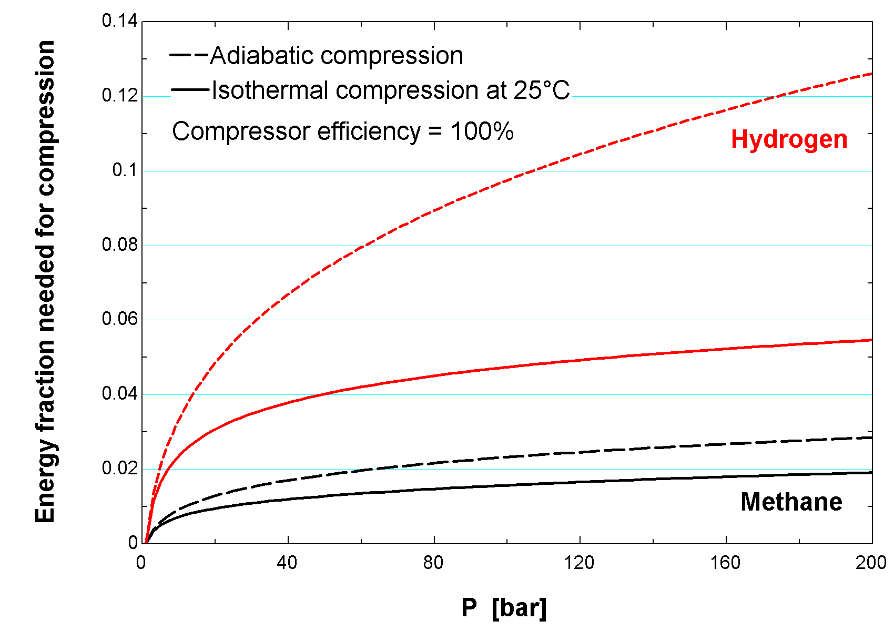
Minimum Energy to Compress Hydrogen
  Comparisons based on same storage pressure but methane has much higher density
Notes:
Carbon capture and storage technologies allow emissions of carbon dioxide to be ‘captured’ and ‘stored’ i.e. they are removed from the exhaust gases of the power station (either from conventional combustion or from gasification), and stored in such a way that they do not enter the atmosphere – thus reducing global warming.
Carbon storage is not yet cost-effective, but the required technologies are already proven and have been used commercially in other areas such as the food industry and chemicals industry. The key is to bring the different elements together at an acceptable cost, and research is ongoing to achieve this goal.

Slide 65
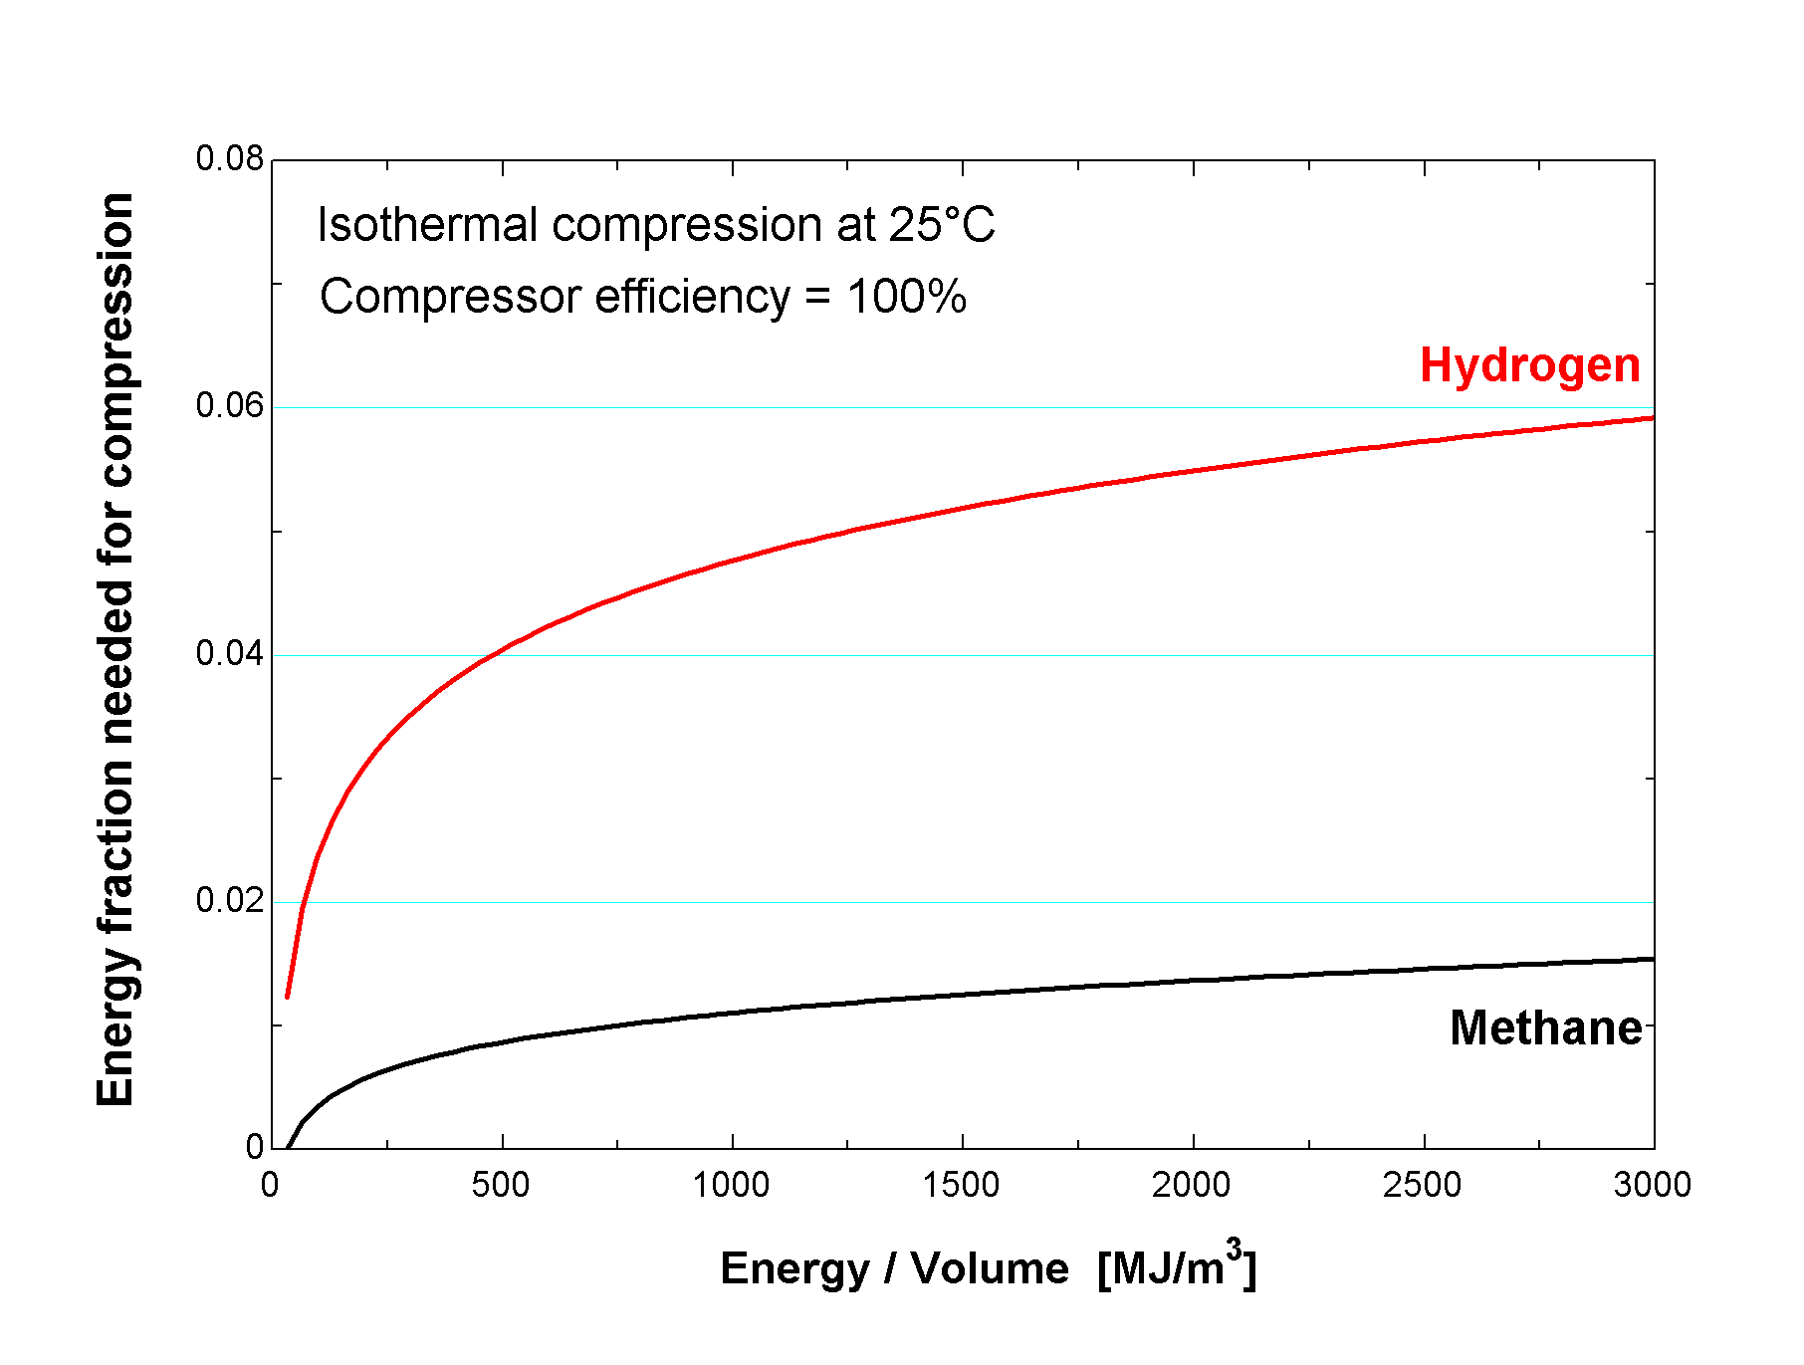
Minimum Energy to Compress Hydrogen
(332 bar)
(100 bar)
Current pipeline
pressure
Compress to same energy density for storage and transport; Hydrogen requires 3 to 4 times as much energy as methane for compression
Notes:
Carbon capture and storage technologies allow emissions of carbon dioxide to be ‘captured’ and ‘stored’ i.e. they are removed from the exhaust gases of the power station (either from conventional combustion or from gasification), and stored in such a way that they do not enter the atmosphere – thus reducing global warming.
Carbon storage is not yet cost-effective, but the required technologies are already proven and have been used commercially in other areas such as the food industry and chemicals industry. The key is to bring the different elements together at an acceptable cost, and research is ongoing to achieve this goal.

Slide 66
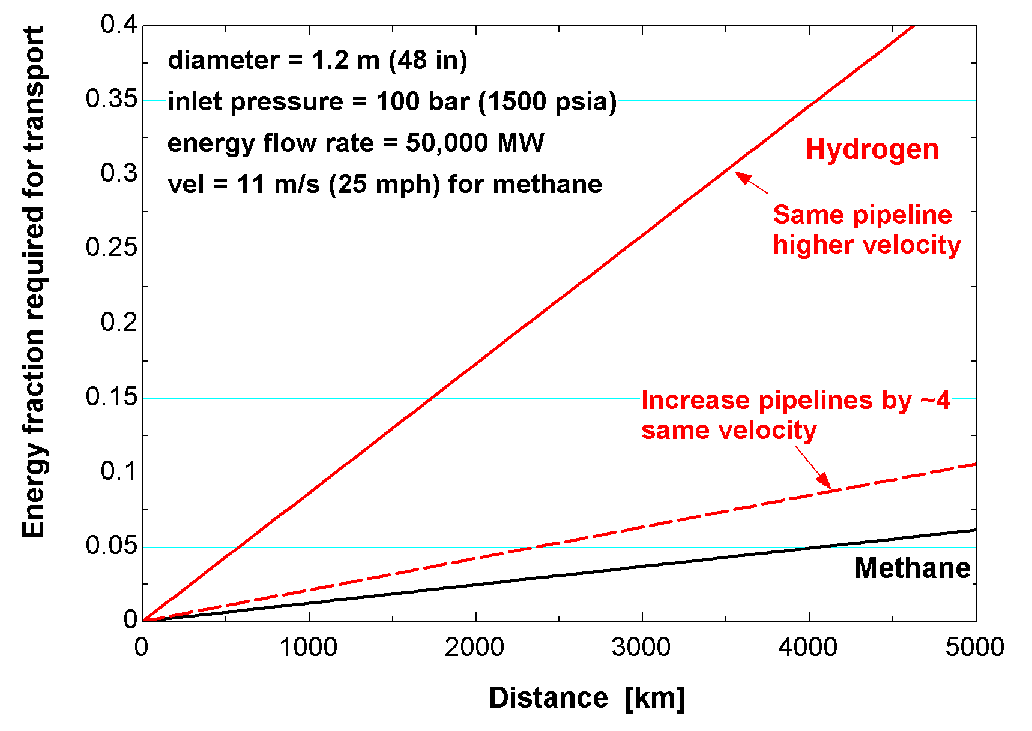
Minimum Energy for Pipeline Transport
Comparisons for equivalent energy flow rates at 100 bar; Hydrogen requires ~ 2-7 times as much transport energy
Notes:
Carbon capture and storage technologies allow emissions of carbon dioxide to be ‘captured’ and ‘stored’ i.e. they are removed from the exhaust gases of the power station (either from conventional combustion or from gasification), and stored in such a way that they do not enter the atmosphere – thus reducing global warming.
Carbon storage is not yet cost-effective, but the required technologies are already proven and have been used commercially in other areas such as the food industry and chemicals industry. The key is to bring the different elements together at an acceptable cost, and research is ongoing to achieve this goal.

Slide 67
Other Transport Options
Liquefaction
  Normal boiling point of H₂ is 20.4 K
  > 30% of fuel energy is required due to low COP
Truck Transport¹
  Receiver at 40 bar, truck transport at 200 bar
  Standard tank truck can carry 3.2 tons and deliver 2.9 tons of methane
  At 200 bar, only 320 kg of hydrogen are carried with 288 kg delivered
  40% of the fuel energy is required to deliver H₂ 200 km
¹from Eliasson and Bossel, “Future of the Hydrogen Economy”, http://www.efcf.com/reports/

Slide 68
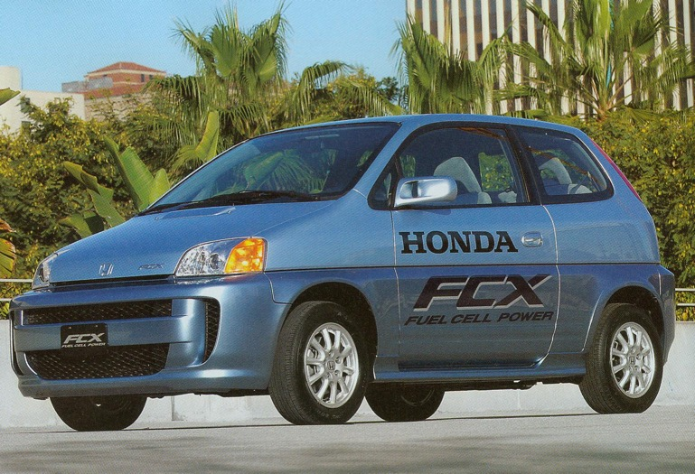
Fuel Cells for Vehicles
Honda FCX-V4
First fuel-cell vehicle approved for American roads
In production from 2002 to 2007
Leasing only
  ~ 30 leased in Los Angeles and Tokyo
Weight: 3,700 lb_{m} (1680 kg). Fuel cell power 78 kW (104 hp). Motor: rated 60 kW.
Fuel: Gaseous hydrogen at 345 bar (3.75 kg) . Range: 170 miles (~45 mpg)
Ultra-capacitors for transient power supply. L. Elliot, H2Nation, Vol. 1, Issue 2, 2004

Slide 69
Currently Available Fuel Cell Vehicles
Car | Years | Pricing | Range | Availability
Hyundai Tucson FCEV | 2014–present | Leasing only US$599 | 265 mi (426 km) | Leased in South Korea, California, Europe and Vancouver
Toyota Mirai | 2015–present | Sales and leasing US$58,500 | 312 mi (502 km) | Sold and leased in Japan, California, Europe and United Arab Emirates. Global sales total of 2,840 units since inception
Honda Clarity | 2016–present | Leasing only US$369 | 300 mi (480 km) | Leased in Japan, Southern California, Europe
Hyundai Nexo | 2018–present | - | 370 mi (600 km) | Sold in South Korea.

Slide 70
Obstacles for Fuel Cell Vehicles
Hydrogen as Fuel
  large high-pressure tanks and limited distance on tank
  new infrastructure required for refilling
Liquid Fuels
  requires reforming (perhaps not with methanol)
  CO must be eliminated
  lower efficiency
  poor time response
Difficult Design Problem
  size, shocks, temperature extremes, transients
  reformation, storage, safety
  reliability...
Why isn’t CNG (methane) used extensively for cars?
  Equiv. energy cost of CNG = $1.32/gal w/o taxes, (1.22 therm/gal)
  CO₂ output is 80% of that from gasoline

Slide 71
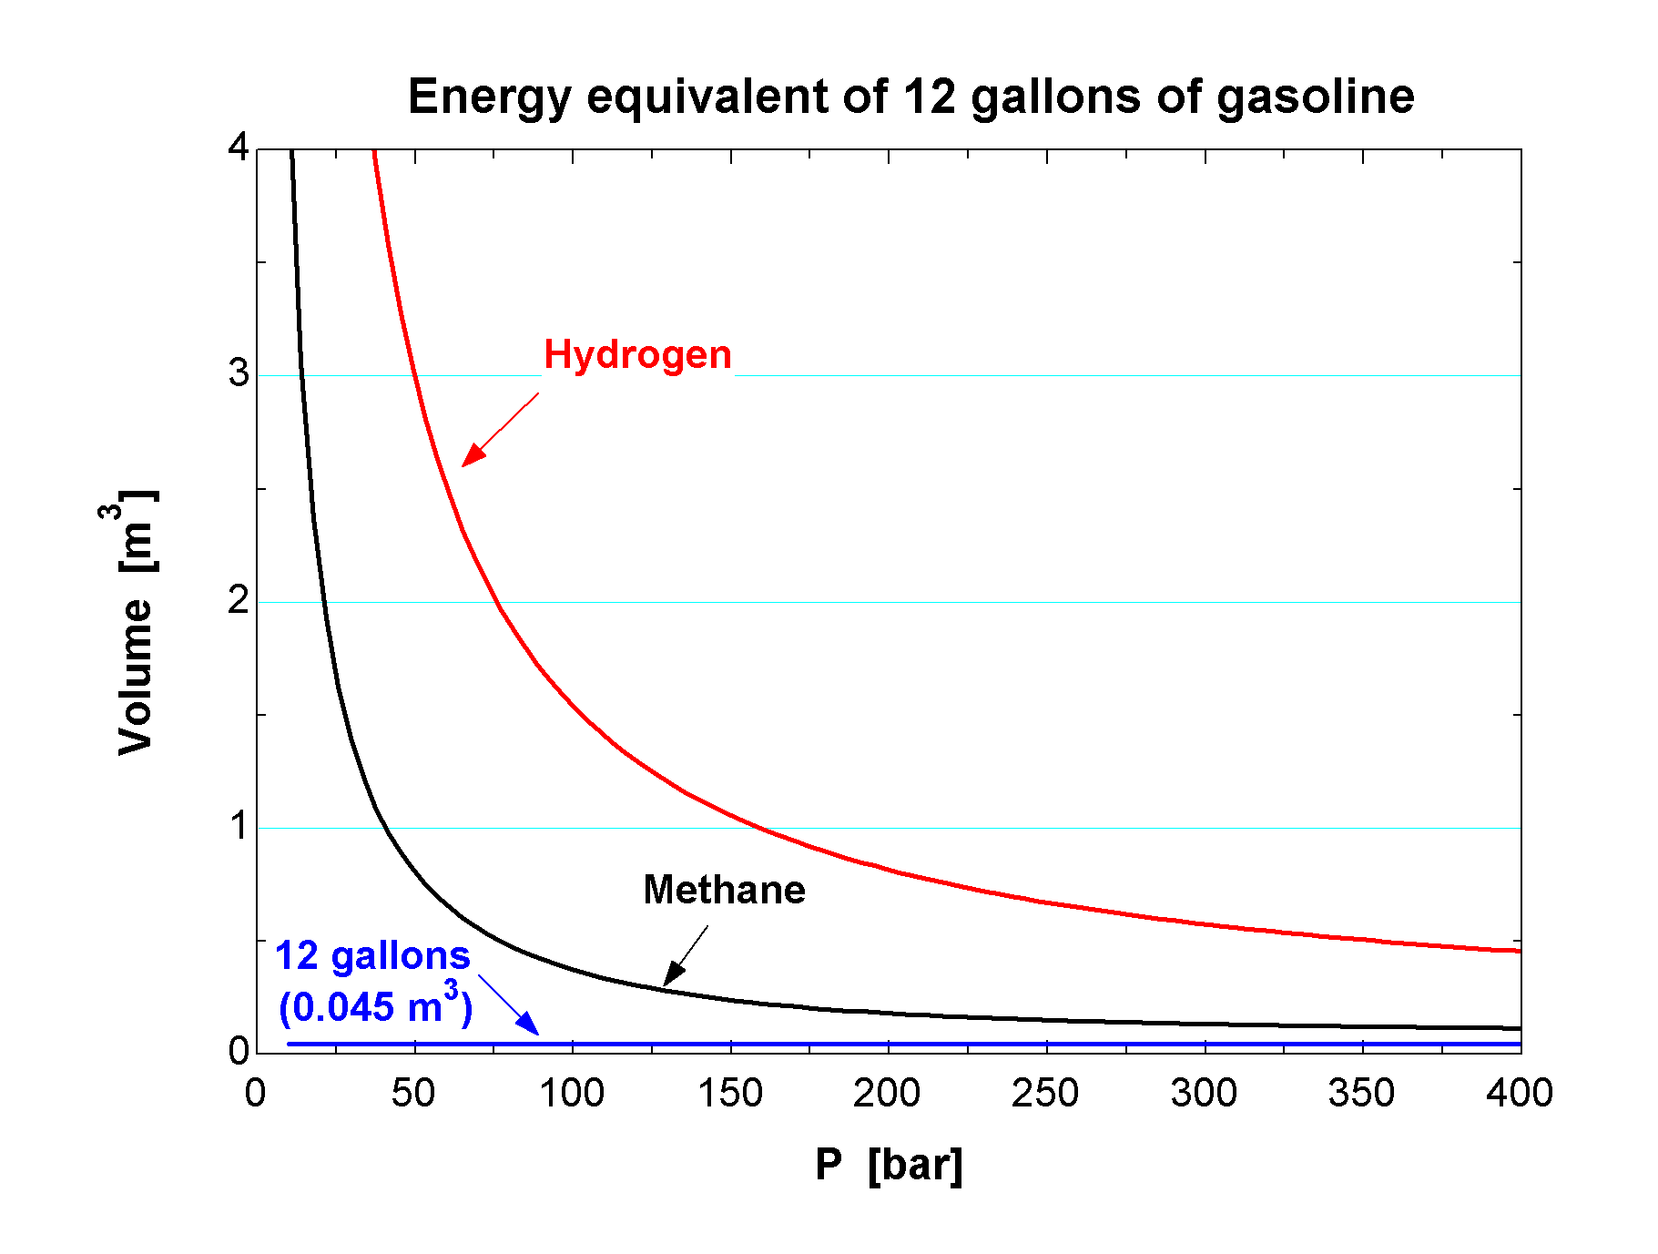
Hydrogen Volume Required for Transport Fuel

Slide 72
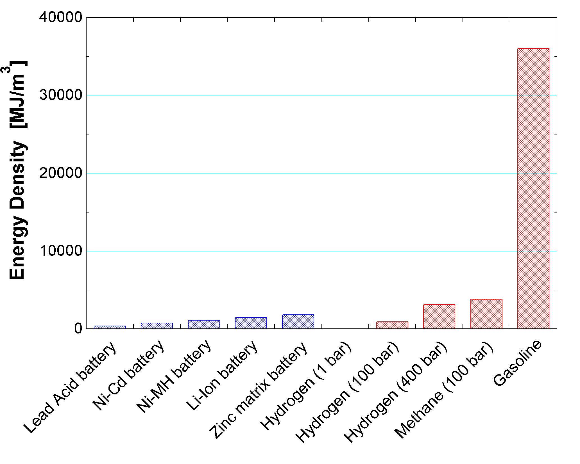
Comparisons with Other Energy Storage

Slide 73
Fuel Cells for Stationary Power
Simpler than vehicular applications
Can be operated directly from natural gas
May be able to use waste heat (cogeneration) thereby improving overall efficiency
Transient operation is less important

Slide 74
Driving Forces For Fuel Cell Development?
Infrastructure
  Difficulty in siting new power plants
  Cost and efficiency losses (5-8%) in transmission
  Power quality and dependability issues
Higher Efficiency
  Efficiency is reduced by fuel processing
  Fuel is relatively inexpensive and plentiful (now)
Lower emissions
  What is the cash value of reduced pollutants?
  Regulatory considerations
  Global warming and political consequences
"The less you know, the better it looks"

