Slide 1
Ocean Energy
Professor Tian Li
School of Mechanical Engineering
Purdue University

Slide 2
Outline
Introduction
Ocean Thermal Energy Conversion (OTEC)
Tidal Energy
Wave Energy

Slide 3
Ocean Energy History
Year(s) | Events
960 AD | Reference to tide mills at Basra in southern Iraq
1041, 1078 | First reference to European tide mills (near Venice)
1100-1900 | Waterwheel-driven mills powered by tidal currents operational in England, western Europe, Colonial Boston
1799 | Gerald files first patent on wave energy device
1871 | Jules Verne’s Captain Nemo posits thermoelectricity from ocean water in 20,000 Leagues Under the Sea
1881 | D’Arsonval proposes concept of ocean thermal energy conversion (OTEC)
1892 | Stahl notes 19 wavepower concepts in American Society of Mechanical (ASME) transactions
1934 | Claude tests open-cycle OTEC in Cuba
1959 | First of a number of small (<1 Mwe) tidal power plants reported in China

Slide 4
Ocean Energy History
Year(s) | Events
1966 | Rance River 240 MW tidal power plant operational in France
1972-1984 | US OTEC program
1976-1982 | British launch, then quash, their wave power program
1977 | Wells invents turbine which rotates in same direction when flow is reversed
1978 | Japanese install 125 kWe wave power off Honshu
1979 | Mini-OTEC operated in Hawaii by US & in Shimane by Japan
1984 | 20 MW Annapolis tidal station operational in Nova Scotia
1991- | Many different wave power concepts developed and tested offshore in northern Europe
2011 | Sihwa Lake 254 MW Tidal Power Plant in South Korea
2006- | Several tidal stream projects developed and under development

Slide 5
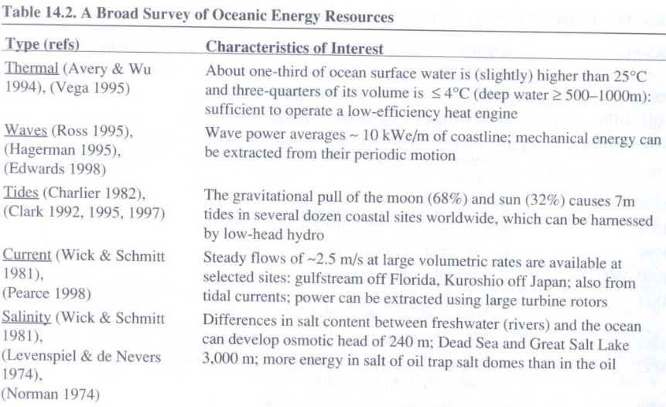
Ocean Energy Resources

Slide 6
Ocean Energy Resources

Slide 7
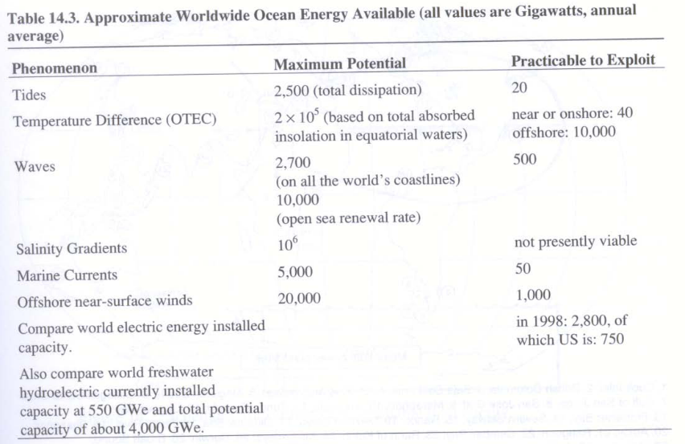
Ocean Energy Resources
Tester et. al (2005)

Slide 8
Ocean Thermal Energy Conversion (OTEC)

Slide 9
Introduction
Utilize temperature gradient in the ocean to operate a Rankine Cycle (solar-driven)
Requires 20 to 25 C temperature difference to produce positive power output
  Available between +20 and -20 degrees latitude
  Top surface is heated by solar radiation
  Pump cold water from several hundred meters below surface
  Broad continental shelves force OTEC plants to operate far offshore (complicates transmission back to land)
  Production of hydrogen and other fuels have been proposed as energy carriers
Two types of technologies
  Open Cycle
  Closed Cycle
An open/hybrid cycle can produce distilled water from salt water as a byproduct
Notes:
There are exception with close location.

Slide 10
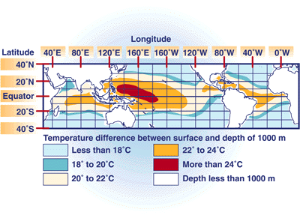
Introduction

Slide 11
Performance Limits
Maximum theoretical efficiency is based on Carnot Cycle (all reversible processes)
Under representative OTEC conditions, T_{h}-T_{c} = 24 C, T_{h} = 300 K,
Low efficiency means that large equipment (e.g., large heat transfer areas, turbines) required for given power requirement
Notes:
All reversible process- produce no work. About 2 times of what is practically possible
Large heat transfer rate for low effeincty.

Slide 12
Practical Limits
Carnot Cycle is limiting case for zero power output
Internally reversible cycle efficiency with finite heat transfer at peak power is:
For T_{h}-T_{c} = 24 C, T_{h} = 300 K:
Also, need to pump cold water from 1000 m below the surface so net efficiency is:
Notes:
Come from finite time thermal model

Slide 13
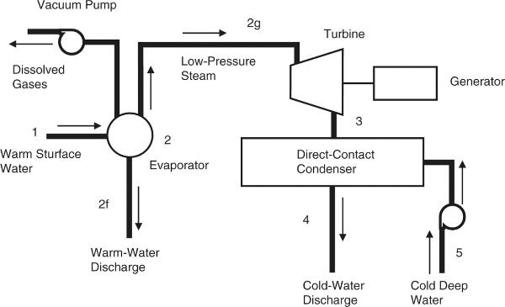
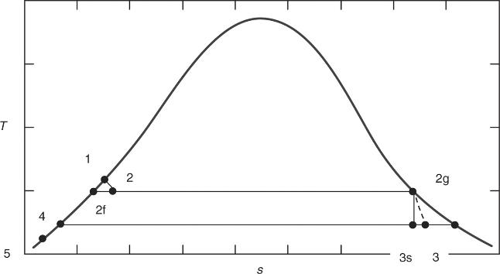
Open
OTEC
Cycle
Hodge, Alternative Energy Systems and Applications, Wiley & Sons, 2010
Doesn’t require indirect heat exchangers
Notes:
By product of distilled water
3 really low pressure

Slide 14
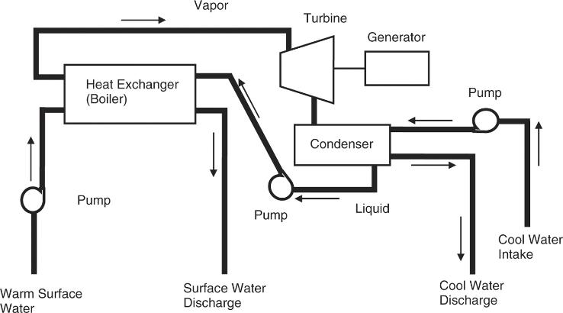
Closed OTEC Cycle
Could use ammonia or propane as a working fluid (higher pressures/densities reduce turbine sizes)
Very large heat exchangers required for evaporator & condenser
Hodge, Alternative Energy Systems and Applications, Wiley & Sons, 2010

Slide 15
Example Closed-Cycle OTEC Requirements
A closed-cycle system uses propane as the working fluid. Warm surface water enters the evaporator at 28 C and leaves at 25 C. The cold water enters at 5 C and leaves at 8 C. The propane evaporating temperature is 22 C, whereas the condensing temperature is 11 C. A turbine with an efficiency of 0.9 produces power at a rate of 125 MW. The evaporator and condenser have unit heat conductances of 1400 W/m²-K.
Propane Flow Rate:
Evaporator Heat Input:
Condenser Heat Rejection:
Warm Water Flow Rate:
Cold Water Flow Rate:
Overall Efficiency:

Slide 16
Example Closed-Cycle OTEC Requirements
Evaporator Area Requirements:
Condenser Area Requirements:

Slide 17
Other Concepts
Hybrid OTEC Systems
  Flash warm surface water into steam
  Use steam to vaporize working fluid (e.g., ammonia) for closed Rankine cycle
  Condensed water is desalinated and can be provided as an additional output
Possible OTEC Outputs
  Electricity
  Desalinated Water
  Air Conditioning/Refrigeration
  Mineral Extraction from Ocean Water

Slide 18
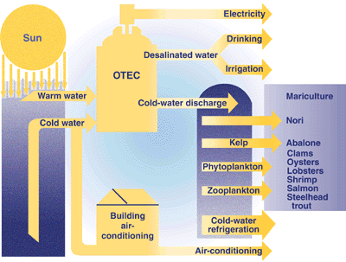
Hybrid Concepts

Slide 19
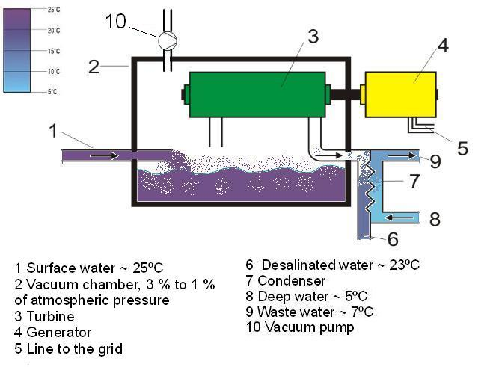
Electricity + Desalinated Water

Slide 20
Tidal Energy

Slide 21
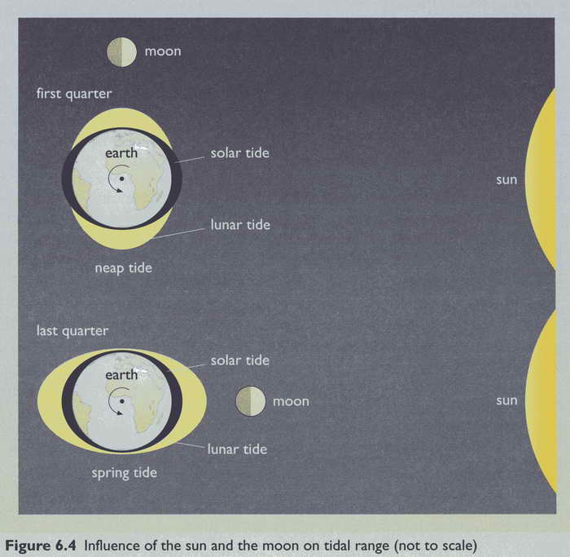
Tidal
Forces
Boyle, Renewable Energy, Oxford University Press (2004)

Slide 22
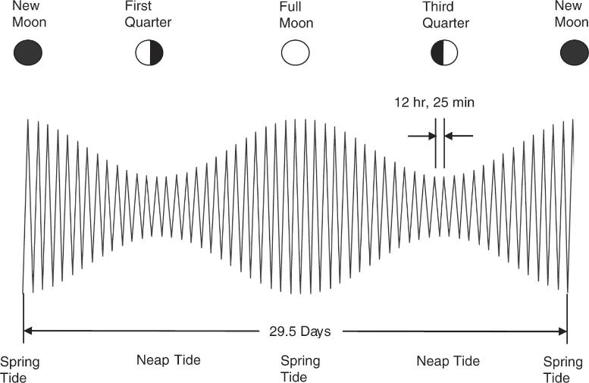
Tidal Variations
Hodge, Alternative Energy Systems and Applications, Wiley & Sons, 2010

Slide 23
Different Tidal Energy Concepts
Tidal Stream Systems
  Make use of the kinetic energy of moving water to power turbines
  Similar to wind power with lower velocities but much higher fluid density
Tidal Barrages
  make use of the potential energy in the difference in height (or head) between high and low tides
  Dams across the width of a tidal estuary
  Relatively few viable sites
Tidal Lagoons
  Similar to barrages, but constructed as self contained structures
  Can be configured to generate power continuously

Slide 24
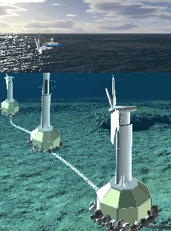
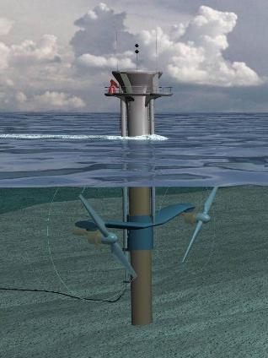
Tidal Stream Turbine Concepts
Swanturbines
MCT Seagen Pile
http://www.darvill.clara.net/altenerg/tidal.htm
Notes:
The "Swanturbines" design is different to other devices in a number of ways. The most significant is that it is direct drive, where the blades are connected directly to the electrical generator without a gearbox between. This is more efficient and there is no gearbox to go wrong. Another difference is that it uses a "gravity base", a large concrete block to hold it to the seabed, rather than drilling into the seabed. Finally, the blades are fixed pitch, rather than actively controlled, this is again to design out components that could be unreliable.
http://www.darvill.clara.net/altenerg/tidal.htm

Slide 25
Turbine Characterization
Power Output
Water density is 800 times the density of air!!
Power output can be significantly increased using shrouded turbines

Slide 26
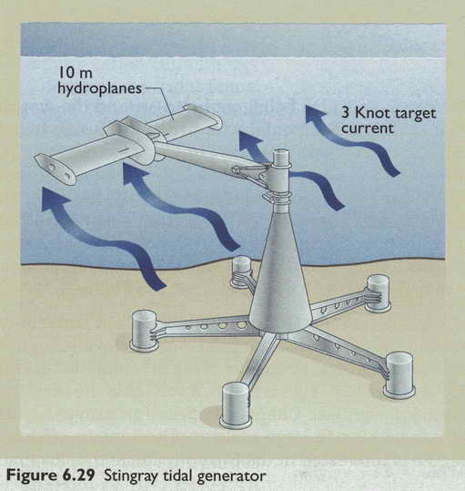
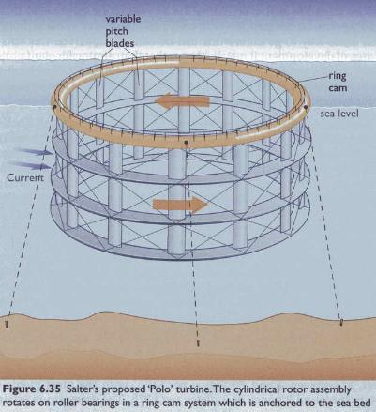
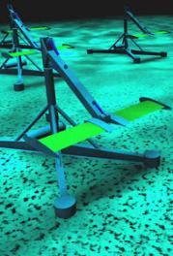
Other Turbine Concepts
Oscillating Tidal Turbine
Polo (vertical) Tidal Turbine
Boyle, Renewable Energy, Oxford University Press (2004)
Notes:
Stingray is designed to extract energy from water that flows due to tidal effects - tidal stream energy.
It consists of a hydroplane which has its attack angle relative to the approaching water stream varied by a simple mechanism. This causes the supporting arm to oscillate which in turn forces hydraulic cylinders to extend and retract. This produces high pressure oil which is used to drive a generator.
http://www.engb.com

Slide 27
Advantages & Disadvantages of Tidal Turbines
Advantages
Low visual impact
  Mainly, if not totally submerged.
Low noise pollution
  Sound levels transmitted are very low
High predictability
  Tides predicted years in advance, unlike wind
High power density
  Much smaller turbines than wind turbines for the same power
Disadvantages
High maintenance costs
High power distribution costs
Intermittent power generation

Slide 28
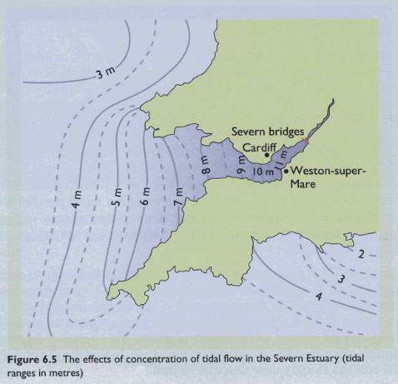
Tidal Barrages
Requires large change in surface height between low and high tide
Requires natural estuary that can be closed off with a dam
Boyle, Renewable Energy, Oxford University Press (2004)

Slide 29
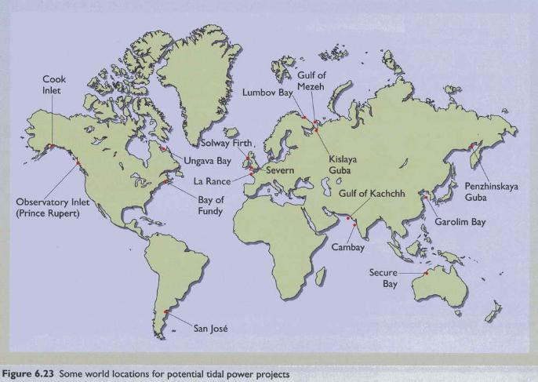
Potential Tidal Barrage Sites
Only about 20 sites in the world have been identified as possible tidal barrage stations
Boyle, Renewable Energy, Oxford University Press (2004)

Slide 30
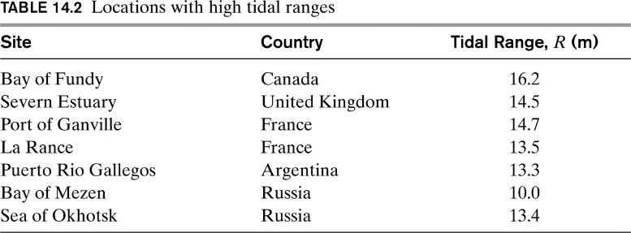
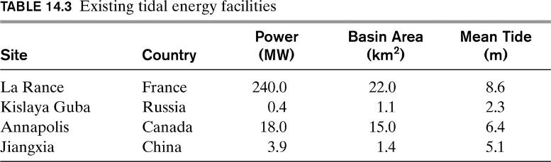
Tidal Barrage Sites
Hodge, Alternative Energy Systems and Applications, Wiley & Sons, 2010

Slide 31
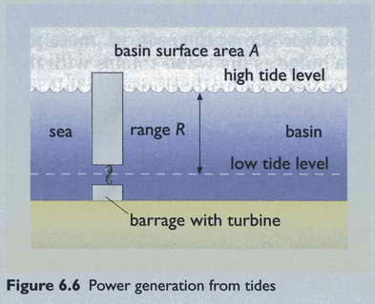
Schematic of Tidal Barrage
“Charge” pool at high tide and/or discharge at low tide
Energy potential depends on tidal range (specific potential energy) and basin surface area (affects water mass)
Can employ reversible turbines for generation during inflow and outflow
Boyle, Renewable Energy, Oxford University Press (2004)

Slide 32
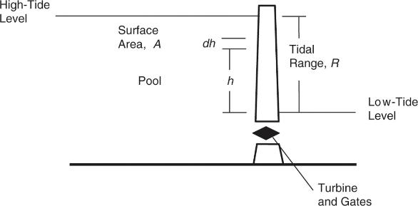
Tidal Barrage Energy Potential
Energy stored within a differential element of height dh above the low tide
For a single discharging (or charging) of a pool, the maximum recoverable work is

Slide 33
Annual Tidal Barrage Energy Potential
There are 706 tidal cycles per year (~ 2 high and 2 low tides each day)
Energy potential is reduced due to several factors
  Turbines and generators are not 100% efficient
  Instantaneous drain or fill is impractical, so difference in head between source and sink is less than full tidal range
  Basin area (hence water volume per unit length will generally decrease with decreasing water depth due to sloping sides of reservoir
For properties of sea water, can express annual energy recoverable potential as
  where η is an overall efficiency (typically between about 0.2 and 0.35)
  Assumes only discharging (or charging) part of cycle is utilized

Slide 34
Example – La Rance Tidal Barrage
The La Rance tidal barrage power station produces about 550 GWh of electricity per year. It has a basin area of 22 km² and the average tidal range is 8.5 m.
"General Properties"
g = 9.8 "acceleration due to gravity, m/s^2"
rho_w = 1025 "sea water density, kg/m^3"
"La Rance Characteristics"
A = 22.5*convert(km^2,m^2) "basin surface area, m^2"
R = 8.5 "basin range, m"
W_act = 550 "actual annual output, GWh"
"Maximum yearly output if only reservoir discharge (or charging) is employed"
W_max = 706*(0.5*rho_w*g*A*R^2)*convert(kg-m^2/s^2,GW-h)
"Average COP for La Rance Tidal Barrage"
eta = W_act/W_max

Slide 35
Example – La Rance Tidal Barrage
Efficiency is relatively low primarily because slow rate of discharge reduces the actual change in height of the reservoir
Higher rates of discharge would require larger turbines and produce more irregular power output
Greater power output when utilizing both charging and discharging of reservoir (1412 vs. 706 cycles per year) with reversible turbine

Slide 36
La Rance Tidal Power Barrage
Rance River estuary, Brittany (France)
Largest in world until recently
Completed in 1966
Length of Dam: 750 m
Area of Basin: 22.5 km²
Tidal Range: 13.5 m (max), 8.5 m (average)
24×10 MW bulb turbines (240 MW)
  5.4 meter diameter
Capacity factor of ~40%
Maximum annual energy: 1.6 TWh
Realized annual energy: 500-600 GWh
Electric cost: 3.7¢/kWh

Slide 37
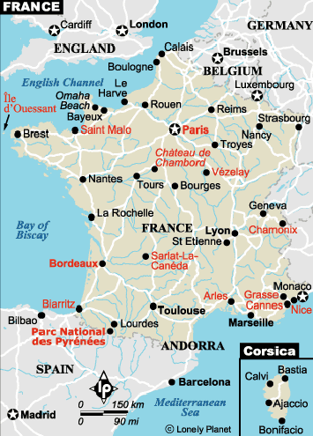
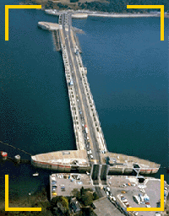
La Rance River, Saint Malo

Slide 38
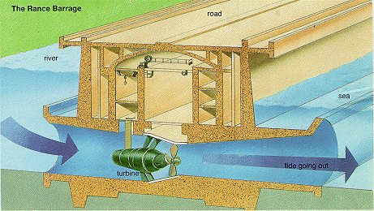
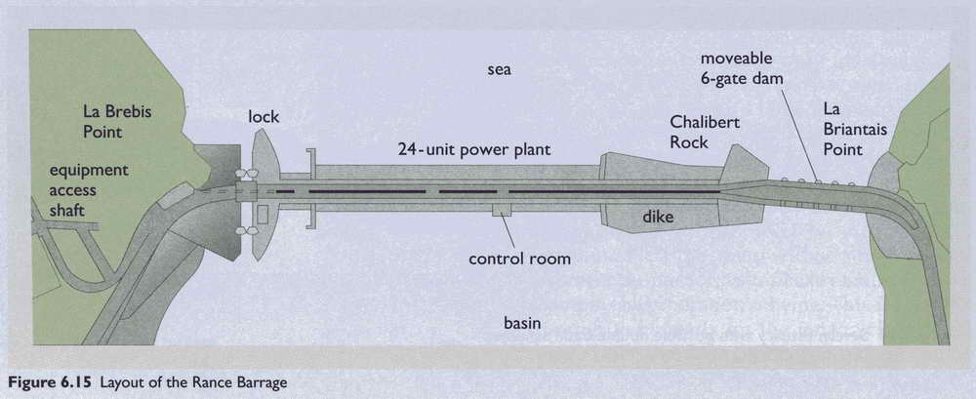
La Rance
Barrage
Schematic
http://www.calpoly.edu/~cm/studpage/nsmallco/clapper.htm
Boyle, Renewable Energy, Oxford University Press (2004)

Slide 39
Proposed Severn Barrage (1989)
Severn River estuary
  Border between Wales and England
216 × 40 MW turbine generators (9.0m dia)
8,640 MW total capacity
17 TWh average energy output
Ebb generation with flow pumping
16 km (9.6 mi) total barrage length
£8.2 ($15) billion estimated cost (1988)
Proposal developed, but never built
  instructive to review proposed design and economics

Slide 40
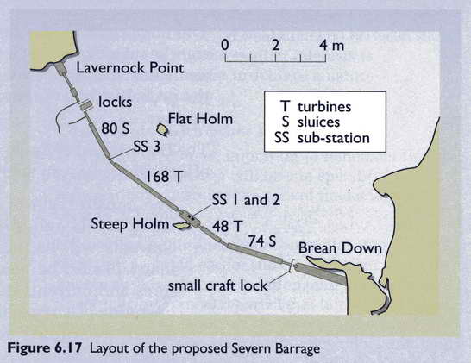
Severn Barrage Proposed Layout
Boyle, Renewable Energy, Oxford University Press (2004)

Slide 41
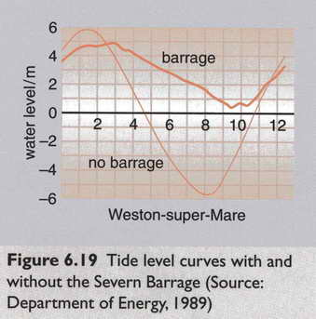
Estimated Effect on Tide Levels
Boyle, Renewable Energy, Oxford University Press (2004)

Slide 42
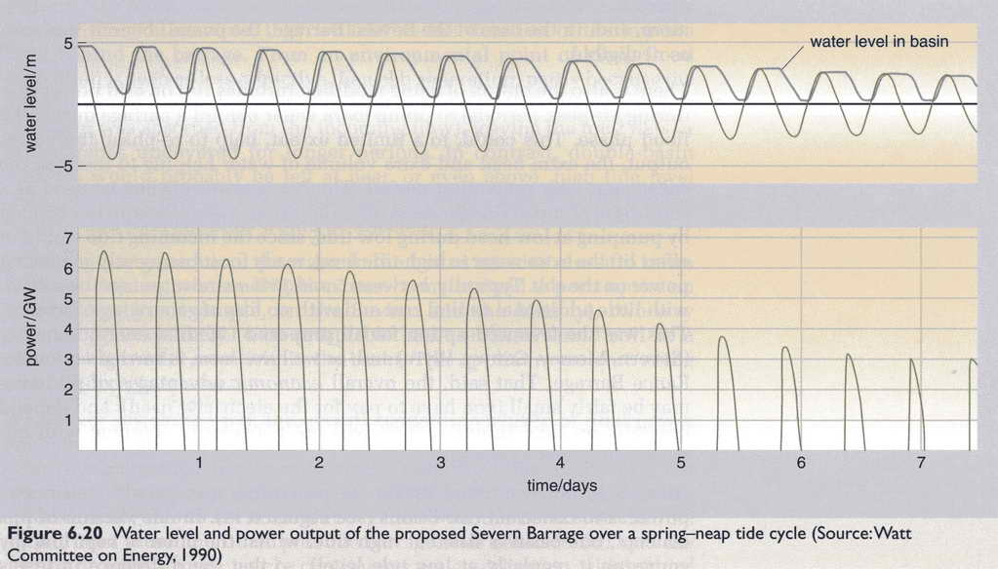
Estimated Power Generation over Time
Boyle, Renewable Energy, Oxford University Press (2004)

Slide 43
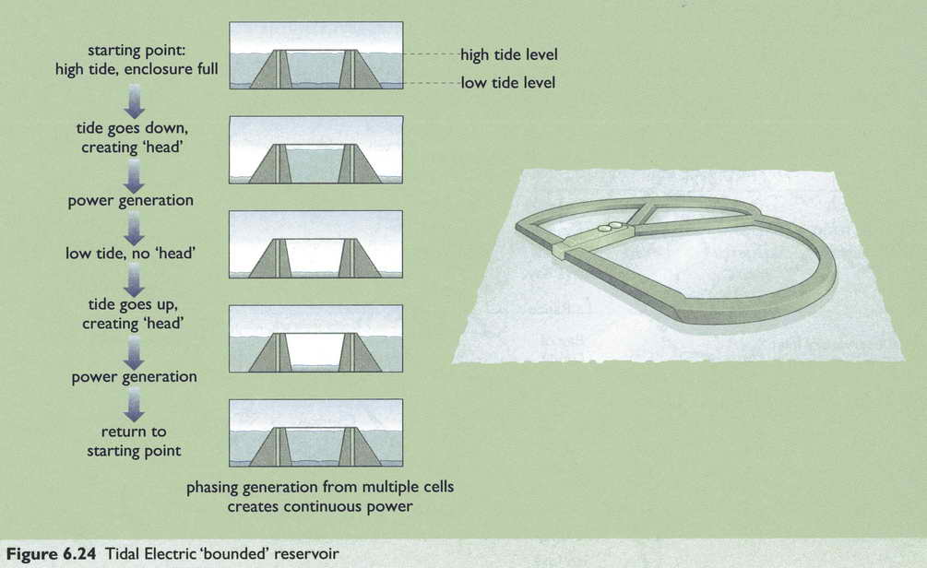
Offshore Tidal Lagoon
Boyle, Renewable Energy, Oxford University Press (2004)

Slide 44
Advantages & Disadvantages of Tidal Barrages
Advantages
High predictability
  Tides predicted years in advance, unlike wind
Similar to low-head dams: known technology
Protection against floods
Benefits for transportation (bridge)
Some environmental benefits: e.g., less turbidity – clearer water
Disadvantages
High capital costs
Few attractive tidal power sites worldwide
Intermittent power generation
Silt accumulation behind barrage
  Accumulation of pollutants in mud
Changes to estuary ecosystem
  less variation in tidal range, fewer mud flats

Slide 45
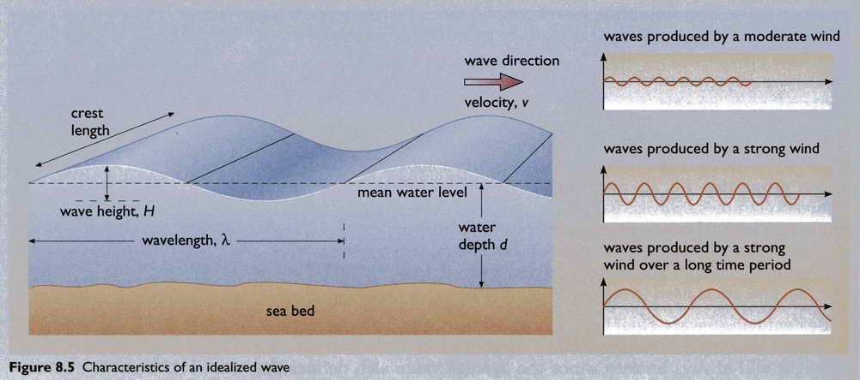
Wave Energy
Boyle, Renewable Energy, Oxford University Press (2004)

Slide 46
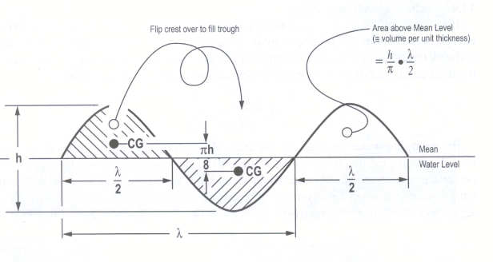
Simple Wave Energy Model
Model assumes
  Sinusoidal traveling wave
  Kinetic energy of wave equals potential energy of wave
The potential energy of an individual wave above the low water level per unit width of wavefront is approximately

Slide 47
Simple Wave Energy Model
Kinetic energy of the wave is approximately equal to the potential energy so that the total wave energy per unit width is:
Wavelength can be approximated in terms of the period (τ) as
Average “power” per unit width of a wave is the total energy per unit width divided by the period of the wave (energy per unit time):

Slide 48
Simple Wave Energy Model
Conversion to power per unit wave area (A = λW) gives
Can also relate to the wave frequency (f = 1/τ) or the wave speed (V = λ/τ)
Comparison with result in the book that uses the wave amplitude instead of wave height (a = h/2)

Slide 49
Example – Wave Energy Potential
A 2-m ocean wave has a period of 5 seconds. Estimate the wavelength, the wave velocity, and the maximum power that can be recovered per unit width of the wavefront and per unit area of the wave.
"General Properties"
g = 9.8 "acceleration due to gravity, m/s^2"
rho_w = 1025 "sea water density, kg/m^3"
"Given Wave Characteristics"
h = 2 "wave height, m"
T = 5 "wave period, s"
"Wavelength and Velocity"
Lambda = g*T^2/(2*pi) "wavelength, m"
V = Lambda/T "velocity, m/s"

Slide 50
Example – Wave Energy Potential
"Power per unit width of wave front"
P_max = 1/16/pi*rho_w*g^2*h^2*T*convert(kg-m/s^3,kW/m)
"Power per unit area of the wave"
P_dens = P_max/Lambda

Slide 51
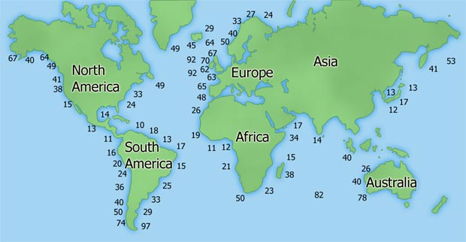
Global Wave Energy Averages
Average wave energy (est.) in kW/m (kW per meter of wave width)
http://www.wavedragon.net/technology/wave-energy.htm

Slide 52
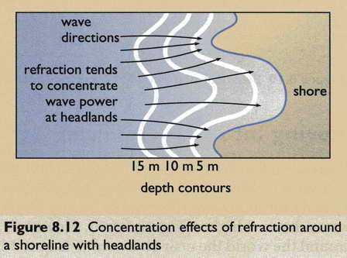
Wave Concentration Effects
Boyle, Renewable Energy, Oxford University Press (2004)

Slide 53
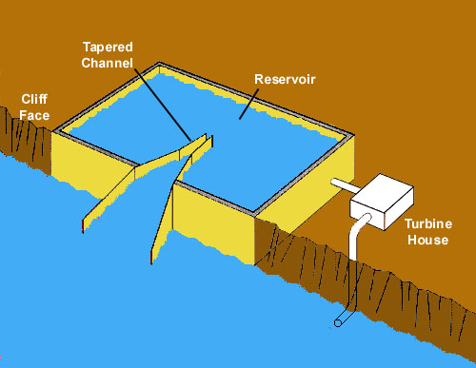
Tapered Channel (Tapchan)
Norway

Slide 54
Wave Energy Potential
Potential of 1,500 – 7,500 TWh/year
  10 and 50% of the world’s yearly electricity demand
  IEA (International Energy Agency)
200,000 MW installed wave and tidal energy power forecast by 2050
  Power production of 6 TWh/y
  Load factor of 0.35
  DTI and Carbon Trust (UK)
Notes:
Potential world-wide wave energy contribution to the production of electricity is estimated by IEA (International Energy Agency) to be between 10 and 50% of the world’s yearly electricity demand of 15,000 TWh
A recent study by the DTI and Carbon Trust in UK is stating some 200,000 MW installed wave and tidal energy power by 2050 which with a load factor of 0.35 is resulting in a power production of 6 TWh/y. Independent of the different estimates the potential for a pollution free energy generation is enormous
http://www.wavedragon.net/technology/wave-energy.htm

Slide 55
Different Wave Energy Concepts
Methods of Wave Capture
  point absorber or buoy
  surface following, attenuator
  terminator, lining perpendicular to wave propagation
  oscillating water column
  overtopping
Locations
  shoreline, nearshore, and offshore
  some designs incorporate reflectors as a means of increasing wave energy at the point of capture
Power Take-offs
  hydraulic ram
  pump-to-shore
  hydroelectric or air turbine
  linear electrical generator

Slide 56
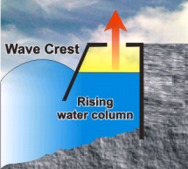
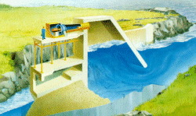
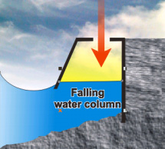
Oscillating Water Column
http://www.oceansatlas.com/unatlas/uses/EnergyResources/Background/Wave/W2.html
Notes:
The Oscillating Water Column generates electricity in a two step process. As a wave enters the column, it forces the air in the column up the closed column past a turbine, and increases the pressure within the column. As the wave retreats, the air is drawn back past the turbine due to the reduced air pressure on the ocean side of turbine.
Much research is occurring internationally to develop oscillating water columns which require less stringent siting conditions, including the OSPREY and floating columns, such as the Japanese Mighty Whale

Slide 57
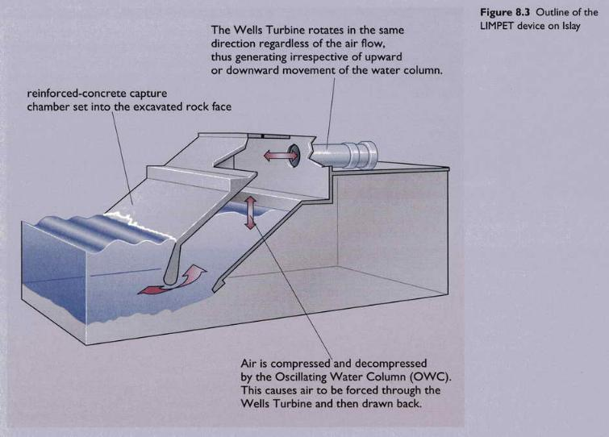
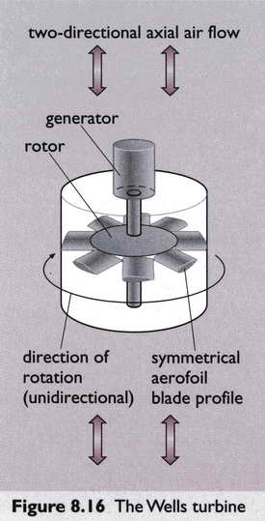
Oscillating Column Cross-Section
Boyle, Renewable Energy, Oxford University Press (2004)

Slide 58
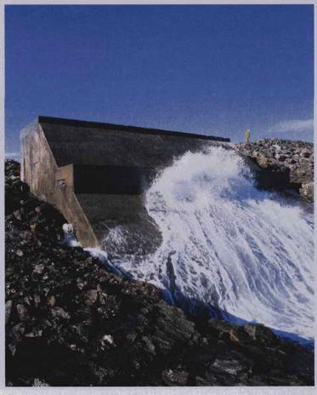
LIMPET Oscillating Water Column
Completed in 2000
Scottish Isles
Two counter-rotating Wells turbines
Two generators
500 kW max power
Boyle, Renewable Energy, Oxford University Press (2004)

Slide 59
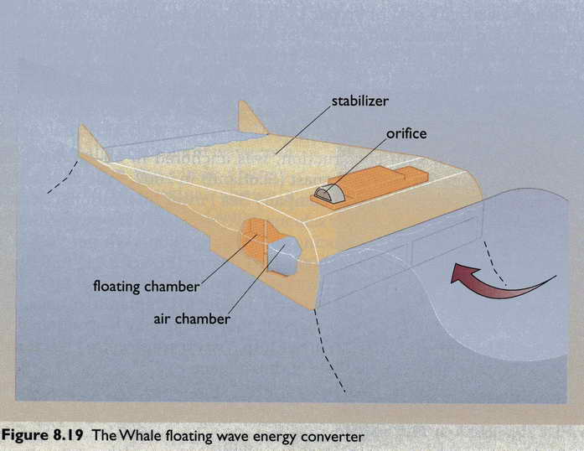
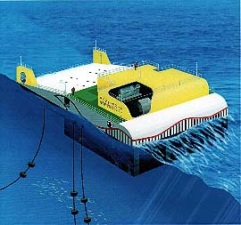
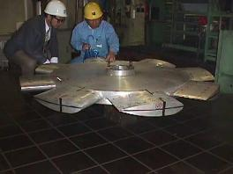
“Mighty Whale” Design – Japan
Boyle, Renewable Energy, Oxford University Press (2004)
http://www.jamstec.go.jp/jamstec/MTD/Whale/
Notes:
Another notable example of an OWC is the “Mighty Whale.” It is the world’s largest offshore floating OWC and was launched in July 1998 by the Japan Marine Science and Technology Center. This prototype, moored facing the predominant wave direction, has a displacement of 4,400 tons and measures 50m long. The Mighty Whale has three air chambers that convert wave energy into pneumatic energy. Wave action causes the internal water level in each chamber to rise and fall, forcing a bi-directional flow over an air-turbine to generate energy. The resulting electricity is supplied mainly to the nearby coastal areas. Storage batteries onboard ensure that electricity is available even during periods of reduced wave activity. It is projected that a row of such devices could be used to supply energy to fish farms in the calm waters behind the devices, and aeration/purification of seawater [7].
http://www.oceansatlas.com/unatlas/uses/EnergyResources/Background/Wave/W2.html

Slide 60
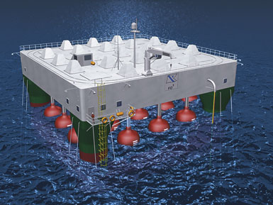
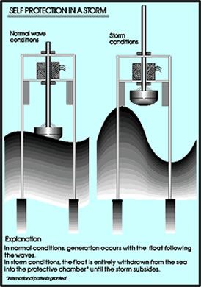
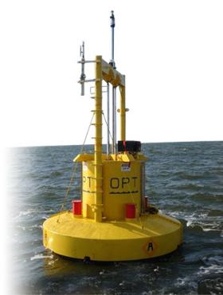
Ocean Buoy Systems
(Point Absorbers)
http://peswiki.com/index.php/Directory:Ocean_Wave_Energy
Notes:
This technology builds upon SARA's pioneering Ocean Wave Energy Conversion system, awarded US Patent 5,136,173; 1992. Unlike alternative concepts that make use of cumbersome intermediate mechanical stages, SARA's approach uses direct conversion of mechanical fluid energy into electricity, via a highly efficient magnetohydrodynamics (MHD) process.
Product:
Rapidly-deployable Wave-powered MHD Electric Generator for the US Navy
Low-cost commercial power for coastal communities.
Benefits:
Almost no moving parts. No gears, no levers, no turbines, no drive belts, no bearings, etc.
Direct, local, and efficient conversion of fluid motion into electricity, with no intermediate mechanical stages.
Highly-compatible with very-strong, but slow-moving, driving forces (ocean waves, for example).

Slide 61
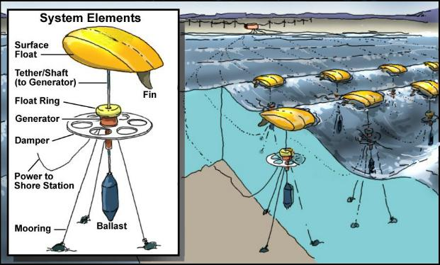
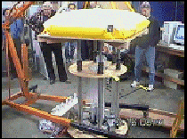
Float with
MHD
Generator
Notes:
This technology builds upon SARA's pioneering Ocean Wave Energy Conversion system, awarded US Patent 5,136,173; 1992. Unlike alternative concepts that make use of cumbersome intermediate mechanical stages, SARA's approach uses direct conversion of mechanical fluid energy into electricity, via a highly efficient magnetohydrodynamics (MHD) process.
Product:
Rapidly-deployable Wave-powered MHD Electric Generator for the US Navy
Low-cost commercial power for coastal communities.
Benefits:
Almost no moving parts. No gears, no levers, no turbines, no drive belts, no bearings, etc.
Direct, local, and efficient conversion of fluid motion into electricity, with no intermediate mechanical stages.
Highly-compatible with very-strong, but slow-moving, driving forces (ocean waves, for example).

Slide 62
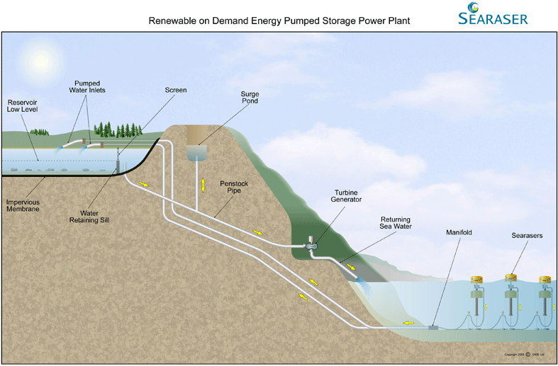
Pumping-to-Shore Concept
http://dartmouthwaveenergy.com/

Slide 63
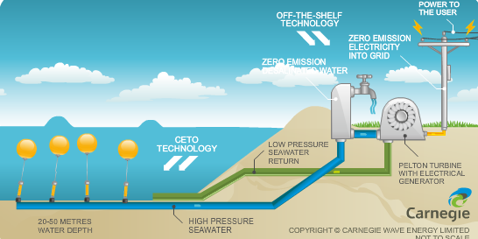
Near-Surface Concept
http://www.carnegiecorp.com.au/index.php?url=/ceto/what-is-ceto

Slide 64
Surface Following Concept - Pelamis
http://www.pelamiswave.com/

Slide 65




Overtopping Device - Wave Dragon
http://www.wavedragon.co.uk/

Slide 66

Declining Wave Energy Costs
Boyle, Renewable Energy, Oxford University Press (2004)

Slide 67

Wave Energy Power Distribution
Boyle, Renewable Energy, Oxford University Press (2004)

Slide 68

Wave Energy Supply vs. Electric Demand
Boyle, Renewable Energy, Oxford University Press (2004)

Slide 69
Wave Power Advantages
Onshore wave energy systems can be incorporated into harbor walls and coastal protection
  Reduce/share system costs
  Providing dual use
Create calm sea space behind wave energy systems
  Development of mariculture
  Other commercial and recreational uses;
Potential for long-term operational life time of plant
Non-polluting and inexhaustible supply of energy
http://www.oceansatlas.com/unatlas/uses/EnergyResources/Background/Wave/W2.html

Slide 70
Wave Power Disadvantages
High capital costs for initial construction
High maintenance costs
Wave energy is an intermittent resource
Requires favorable wave climate
Investment of power transmission cables to shore
Degradation of scenic ocean front views
Interference with other uses of coastal and offshore areas
  navigation, fishing, and recreation if not properly sited
Reduced wave heights may affect beach processes in the littoral zone
http://www.oceansatlas.com/unatlas/uses/EnergyResources/Background/Wave/W2.html
Notes:
High capital costs for initial construction [9] to resist exposure to strong wave forces, storms, and corrosion [10];
Wave energy is an intermittent resource [2];
Requires favorable wave climate. The highest concentration of wave energy occurs between the latitudes 40° and 60° in each hemisphere, which is where the winds blow most strongly. Latitudes of around 30° of the equator due to the regular trade winds may also be suitable for exploitation of wave energy [11];
Offshore wave energy systems require investment power transmission cables for electrical connections to shore [11];
Degradation of scenic ocean front views from wave energy devices located near or on the shore, and from onshore overhead electric transmission lines [10];
Potential interference with other uses of coastal and offshore areas such as navigation, fishing, and recreation if not properly sited [2];
By reducing the height of waves they may affect beach processes in the littoral zone [2].

Slide 71
Wave Energy Summary
Potential as significant power supply (1 TW)
Intermittence problems mitigated by integration with general energy supply system
Many different alternative designs
Complimentary to other renewable and conventional energy technologies
http://www.oceansatlas.com/unatlas/uses/EnergyResources/Background/Wave/W2.html
Notes:
Ocean waves have the potential to contribute up to one TW to the global energy supply.
The problems associated with the intermittence of wave energy can be smoothed by integration with the general energy supply system.
Many different wave power plants, some of them multi-purpose, have been proposed, assessed, and cost-estimated
With the development of large-scale demonstration and commercial power plants underway, wave energy will begin to play an increasing role in complementing other renewable and conventional energy technologies to meet global needs.

